Slide 1
GOES-19 Solar UltraViolet Imager (SUVI)
Provisional PS-PVR
2025 February 25
Jonathan Darnel, Christian Bethge, Alison Jarvis
GOES-R Calibration Working Group
CIRES, Univ. of Colorado & NOAA NCEI

Slide 2
Agenda
SUVI Instrument Overview
Review of Current ADRs
Product Quality Evaluation
General approach
Major Issues Remaining
Provisional Maturity Assessment
Path to Full Validation Maturity
Issues and status
PLPT
Risks
Summary and Recommendations

Slide 3
Commonly-Used Acronyms (CUAs)
ADR : Algorithm Discrepancy Report
AIA : Atmospheric Imaging Assembly
BSV : Below Solar Variability
CCD : Charge-Coupled Device
EUV : Extreme UltraViolet
EXIS : EUV and X-ray Irradiance Sensor
FITS : Flexible Image Transport System
LUT : Look-Up Table
OMAS : Operational Metadata Aggregation Service
SDO : Solar Dynamics Observatory
SUVI : Solar UltraViolet Imager
WR : Work Request

Slide 4
Overview of the SUVI Instrument and the SUVI Level-1b Product

Slide 5
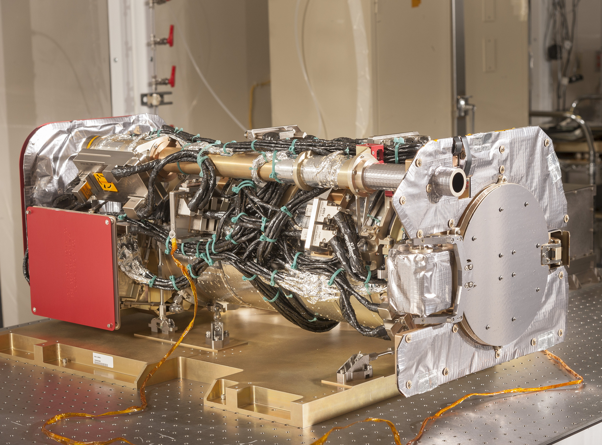
The SUVI Instrument

Slide 6
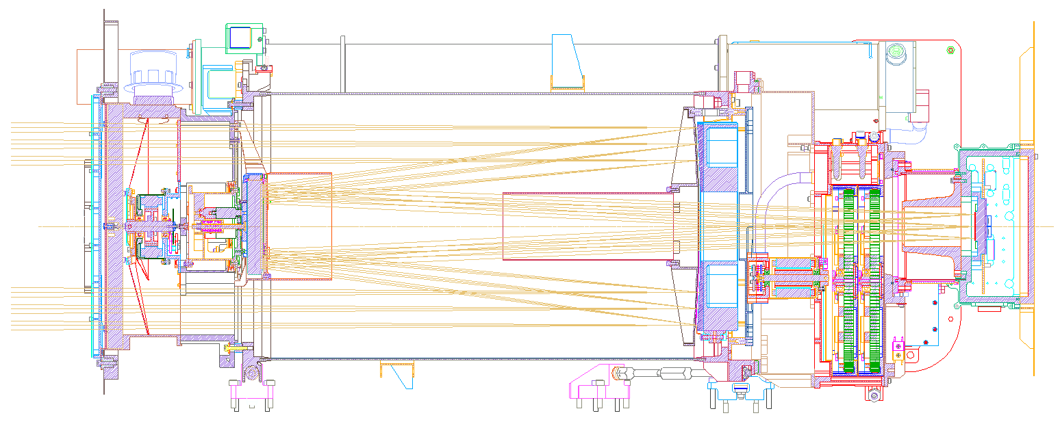
Primary Mirror
Entrance Filter
Secondary Mirror
Focal Plane Filters
CCD
Detector

Slide 7
Key SUVI Imaging Requirements
Pointing knowledge: < 2.5 arcsec
Pointing accuracy & stability: < 0.5 arcsec
Field of view: > 42×42 arcmin
Spatial resolution: < 5 arcsec square pixels
Ensquared energy: > 50% in 7×7 square arcsec
(43% for 94 Å bandpass)

Slide 8
Key SUVI Instrument Characteristics
1280×1280 pixels
2.5 arcsec pixels, 53.5×53.3 arcmin FOV
14-bit CCD detector
Entrance aperture selector – 6 positions
2 Filter wheels:
FW1: Open, Thin Al & Zr, Thick Al & Zr
FW2: Glass, Open, Thin Al, Thin Zr, Thick Al
4-photodiode guide telescope for pointing

Slide 9
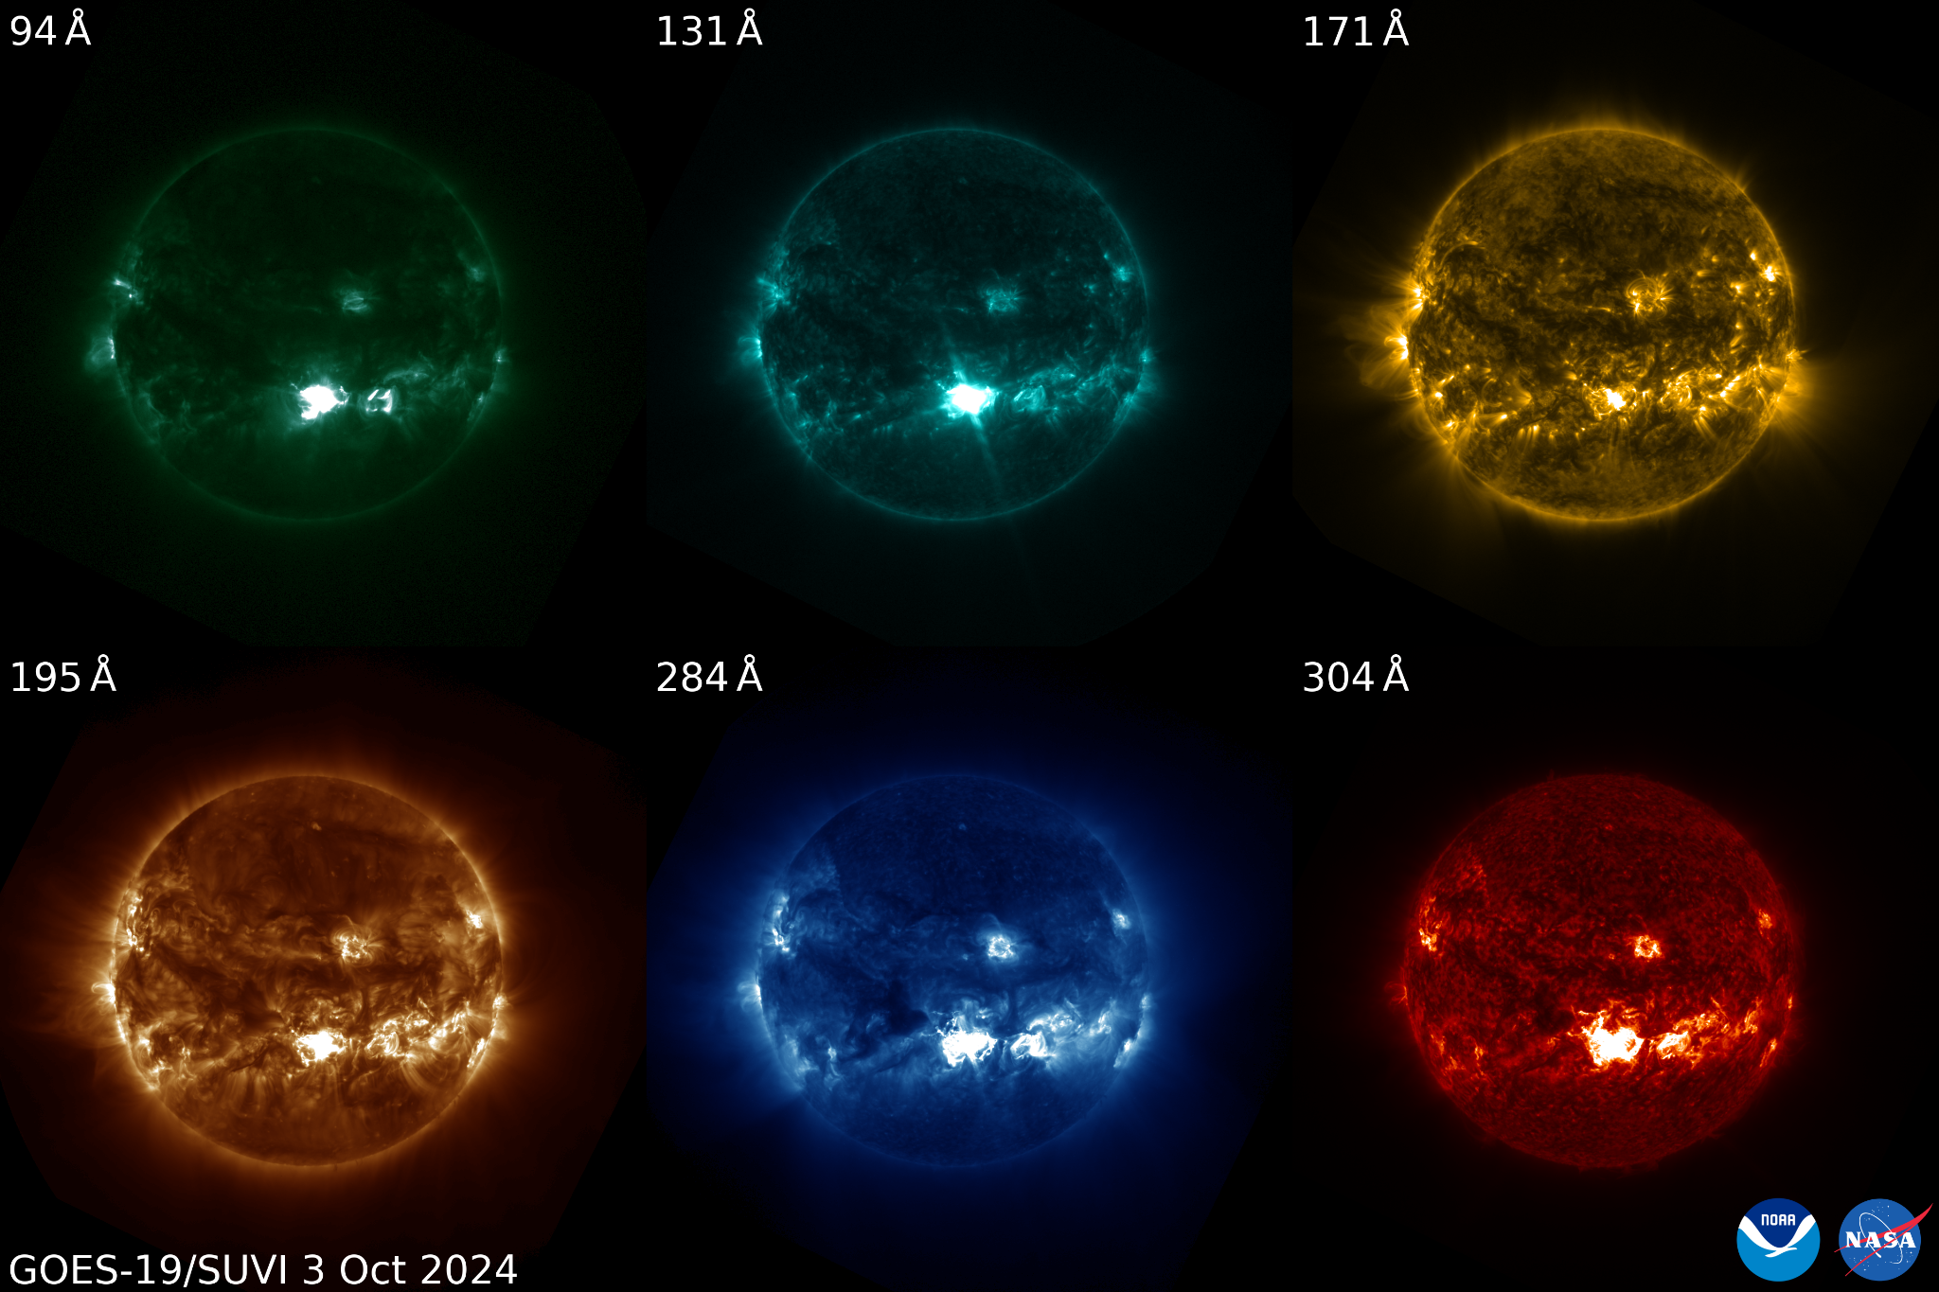
SUVI EUV Channels

Slide 10
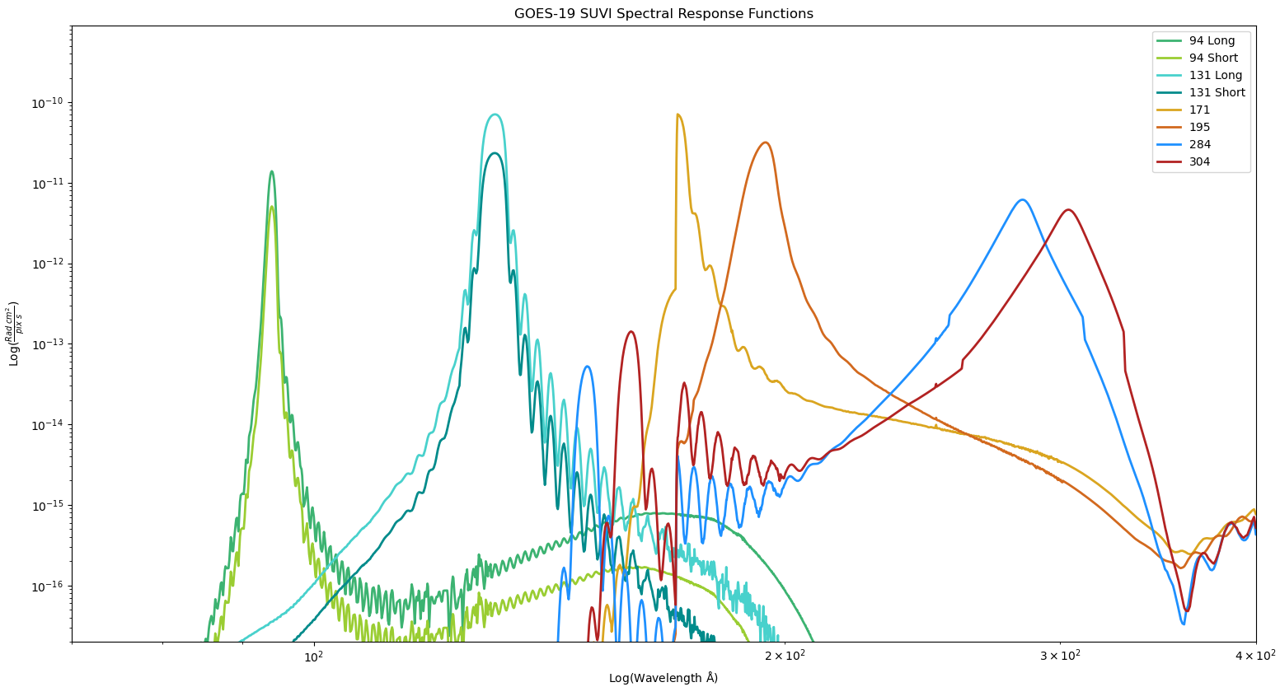
SUVI Spectral Response Functions

Slide 11
File Formats:
netCDF vs. FITS
The SUVI L1b product is produced in both netCDF and FITS formats
The standard file format for the astrophysical community is FITS
NWS/SWPC and NCEI Level-2 algorithms expect FITS files
NCEI-CO considers the SUVI L1b FITS product as the standard, and these data are used for PLPT activities.

Slide 12
Current Look-up Table Filenames
Current GOES-19 SUVI Calibration LUT:
SUVI_CalibrationParameters(FM4A_CDRL79revC_PR_14_00_04)-791270600.0.h5
Current GOES-19 SUVI Navigation LUT:
SUVI_NavigationParameters(FM4A_CDRL79revB_PR_14_00_03)-789806200.0.xml

Slide 13
GOES-19 SUVI ECI Campaigns
Filtered 171/195 Å combo from the ECI Phase 2 (22-25 Oct 2024). The ECI sequence was changed with respect to prior campaigns. The movie was made selecting only the frames to fit the old sequence. The shortened ECI Phase 3 (16-30 Jan 2025) has not yet been evaluated.

Slide 14
Review of Pre-Provisional Maturity

Slide 15
Path to Provisional Maturity - Status at Beta
Resolve major GPA concerns.
Verify solutions to issues raised during PLT are resolved.
Fully validate L1b after major outstanding calibration issues (darks, flats) are resolved.
Upload revised calibration tables.
PLPTs to validate instrument calibration and performance, intercalibrate with other instruments.
Daily, weekly and quarterly calibrations underway.
Provisional maturity date. Currently set for “FY25”.

Slide 16
Artifacts from GOES-19 SUVI PLT
Test | Description | Completion Status
PLT-001 | Guide Telescope Calibration | Complete
PLT-002 | Dark Current and LTC | Complete
PLT-005 | Shutter Light Leakage | Complete
PLT-006 | Offband Signal | Complete
PLT-007 | Flatfield Calibration | Complete
PLT-009 | Focus Check | Complete

Slide 17
Current ADRs from Beta
Risk | ADR | WR | Build | Impacts | Comments
Uncorrected Roll Angle Error | 1276 | 9406 | n/a | Causes INR errors due to uncorrected roll. Common to all SUVI instruments | Rejected.
Installation of G19 SUVI INR LUT | 1290 |  | PR.09.08.38 | INR incorrect in G18 SUVI L1b | Resolved December 2024
SUVI INSTRESP metadata not calculated correctly | 1343 | 9721 | Target of DO.15.00.00 |  | Type 2 change tested in Oct ‘24, but formula found to be wrong. Retest still found issues. 1/8/25 - AART - Low priority. Bring back March 5.
SUVI Eclipse Flag missing from predictions | 1431 | 10072 | In_Analysis MM.14.00.00 |  | 12/11/24 - AART - Moved to mm.14. Bring back May 2025.

Slide 18
Current ADRs from Beta
Risk | ADR | WR | Build | Impacts | Comments
G19 SUVI CDRL79 Rev B | 1514 | --- | PR.13.10.05 |  | 12/11/24 - AART - Deployed on the OE Nov 27, 2024
G19 SUVI CDRL79 Rev C | 1532 | --- | TBD |  | 1/8/25 - AART - Delivered; NickC to smoke test on DE Jan 9. Bring back Jan 22.
SUVI yaw flip navigation | 1121 | 8149 | DO.14.00.00 |  | Code fix delivered with DO.14.00.00, but needs an actual yaw flip to close 12/11/24 - AART - Still waiting for a Yaw Flip for verification; hopefully early next year. Bring back Feb 2025.
SUVI 100ms exposures smearing effect | --- | 9744 | Submitted |  | Shutter effect in short exposures. Flight WR.

Slide 19
SUVI Level-1b Product Quality Assessment

Slide 20
Assessment Overview
 | Today | Required/Desired
INR | Correct Pointing and Roll offsets Applied Low-level systematic errors persist Uncorrected roll causes small INR errors | Complete INR LUT maintained
Radiometrics | LUT updated for new calibration factors Degradation Trending activities started. Working to understand differences between G16/17/18/19 | Strategy to disseminate degradation correction factors Degradation trending activities producing consensus results Radiometric measurements of all SUVI instruments are understood and trended Consistency between all SUVI radiometrics.
Usability | All relevant radiometric metadata is included in L1b product Scaling of L1b products is dynamic and accurately reported SUVI data is shared through Helioviewer! SUVI tools in SunPy! | Ease of use by wider scientific community

Slide 21
Post-Launch Product Tests Presented for Provisional
Test ID | Test Title | Operator | Maturity | Status
G19-O-SUVPLPT-001 | SUVI Sequence Test (Active) | GOES-R | Prov. | PASS
PLPT-SUV-001 | SUVI Trending – CCD Temperature | NCEI | Prov. | PASS
PLPT-SUV-003 | SUVI-AIA Intercalibration | NCEI | Prov. | PASS
PLPT-SUV-006 | SUVI-EXIS Intercalibration | NCEI | Prov. | PASS
PLPT-SUV-007 | SUVI-SUVI Intercalibration | NCEI | Prov. | PASS
Test plans and procedures for PLPTs 001, 003, 006, and 007 are given in the SUVI Readiness, Implementation, and Management Plan (RIMP v2.0; 410-R-RIMP-0319)
Plans and procedures for PLPT-001 are given in the G19-O-SUVPLPT-001 PLPT form.

Slide 22
Active PLPT-SUVI-001: SUVI Extended Sequencer
NCEI modified the Extended Sequencer PLPT from GOES-18 for use during GOES-19 SUVI PLPT to test how the SUVI handles exposure times not typically used during operations.
The GOES-19 SUVI Extended Sequencer PLPT ramped SUVI exposure times from 30ms to 740ms in increments of 10ms.

Slide 23
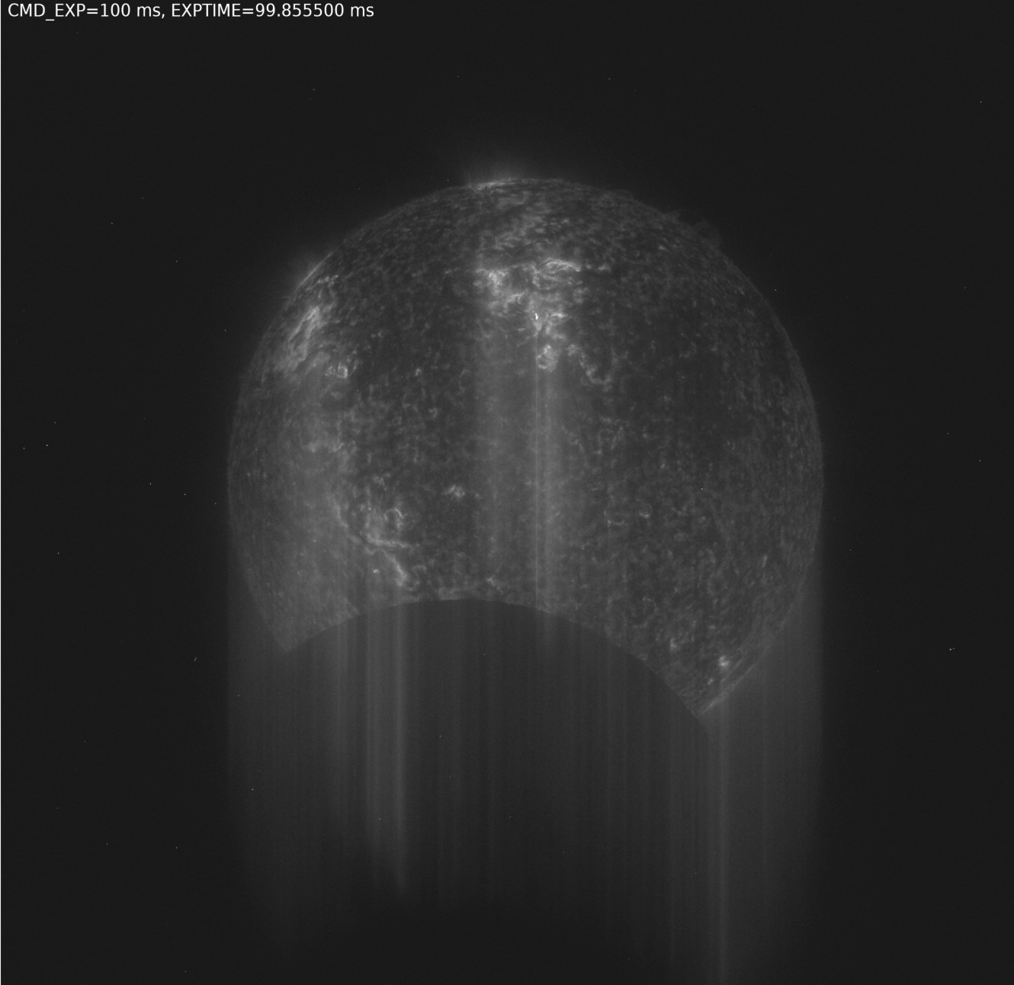
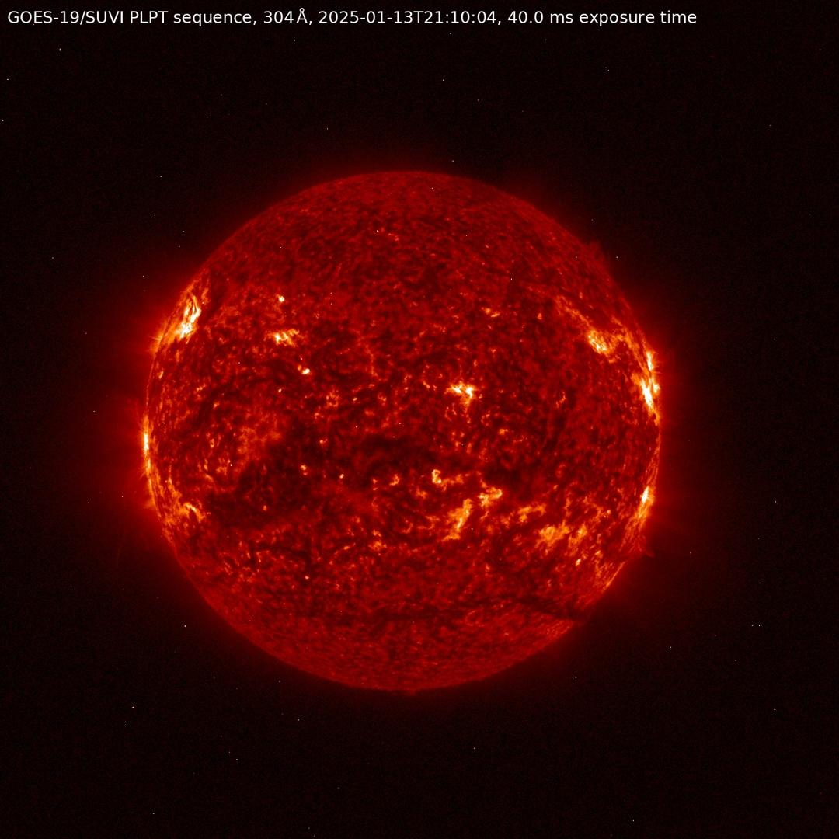
Active PLPT-SUVI-001: SUVI Extended Sequencer
Background for this test: during a special eclipse observing sequence on GOES-18 in March 2023, 100 ms exposures led to image artifacts. It was suspected that this was caused by the CCD reading out already while the shutter was not entirely closed yet. This PLPT sequence took images with a range of increasing exposure times (30-740 ms) to test “safe” exposure times. (Un)fortunately, the effect could not be reproduced.
Image from the eclipse sequence on GOES-18 in 2023

Slide 24
Active PLPT-SUVI-001: SUVI Extended Sequencer
Conclusions:
NCEI sees no obvious artifacts from shutter movements in data from PLPT-SUVI-001 due to non-typical exposure times
If operational exposure times are changed, test sequences should be carried out first (3-6 hrs) to make sure there are no issues

Slide 25
PLPT-SUVI-001: SUVI CCD Temperature Trending
Demonstrate the ability to extract and trending SUVI CCD Temperatures
Stability in detector temperature is important to removing noise from the SUVI Level-1b product.
Instability in detector temperature is indicative of anomalous instrument behaviour.

Slide 26
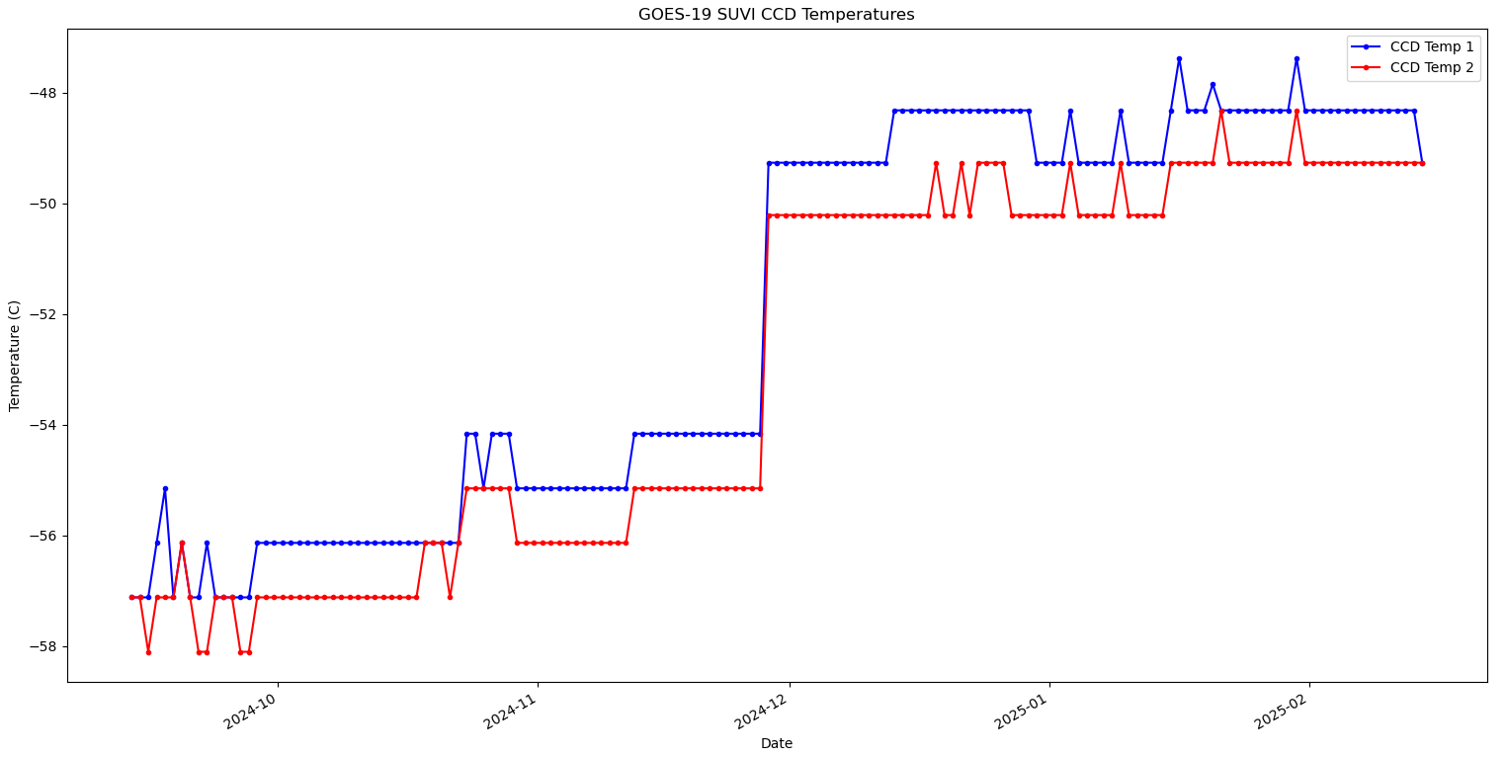
PLPT-SUVI-001: SUVI CCD Temperature Trending
Set Point at -50°
Set Point at -48°

Slide 27
PLPT-SUVI-001: Summary
-50° temperature setpoint for operations was implemented on 27 November 2024.
The SUVI vendor advised to adjust the operational setpoint by +2° due to observed diurnal variations. This was implemented on 15 January 2025.
The temperature trends since 15 January 2025 has been stable.

Slide 28
Interlude - SUVI Ground Calibration
The SUVI instruments were calibrated on an individual component basis.
Instrument-level testing was limited to alignment checks (white light, without filters) or “sanity-check” tests (low-level in-band irradiance)
The SUVI mirror pairs went through extensive in-band testing
Testing occurred over 15 years ago
The impact of aging on mirror performance has not been tested
The CCD quantum efficiency was measured at a limited number of wavelengths
A quantum efficiency model was constrained using these measurements.
Fresh (untested) filters are installed onto the SUVI instrument pre-flight.
Reference filters manufactured to the same specifications were tested at LBNL ALS facility.
Measurements from witness samples are used to constrain the filter transmission model.
There are many contributions to the uncertainty of the overall SUVI response
These uncertainties most likely contribute to the measured differences between the different SUVI instruments and SUVI/AIA

Slide 29
PLPT-SUVI-003: SUVI-AIA Intercalibration
Full field performance comparison via AIA-to-SUVI transformation and ratio (assesses flat field, focus and point-spread-function, bad pixels, and other image artifacts).
Radiometric inter-comparison via SUVI/AIA ratio versus theoretical expectations based on SUVI/AIA spectral response functions.
To ensure sufficient signal-to-noise only on-disk pixels are used for radiometric analysis.
Note: due to the JSOC issues distributing recent SDO data, this analysis refers to data taken on 3 Oct 2024, before the GOES-19/SUVI data has been flatfielded, and before the throughputs have been updated.

Slide 30
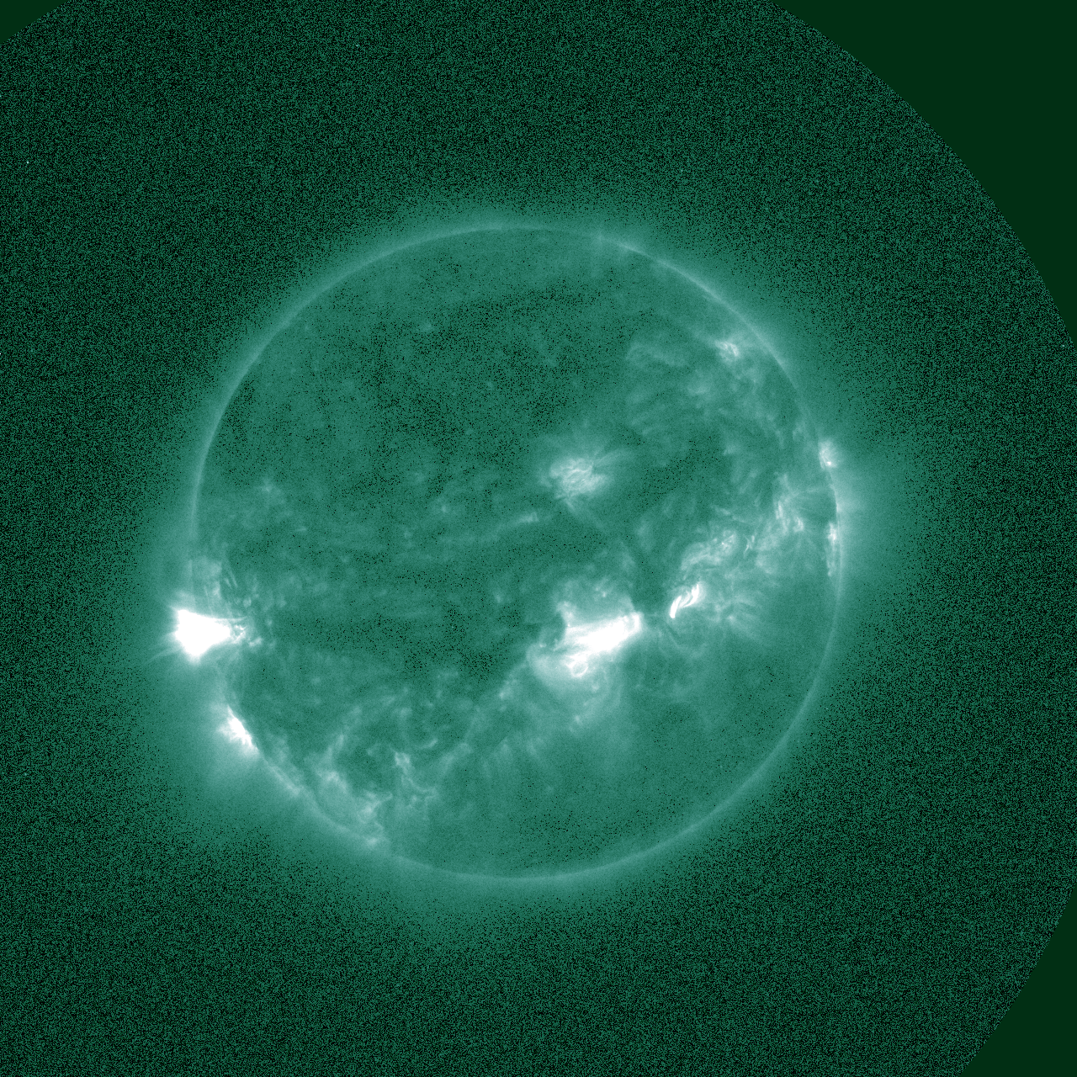
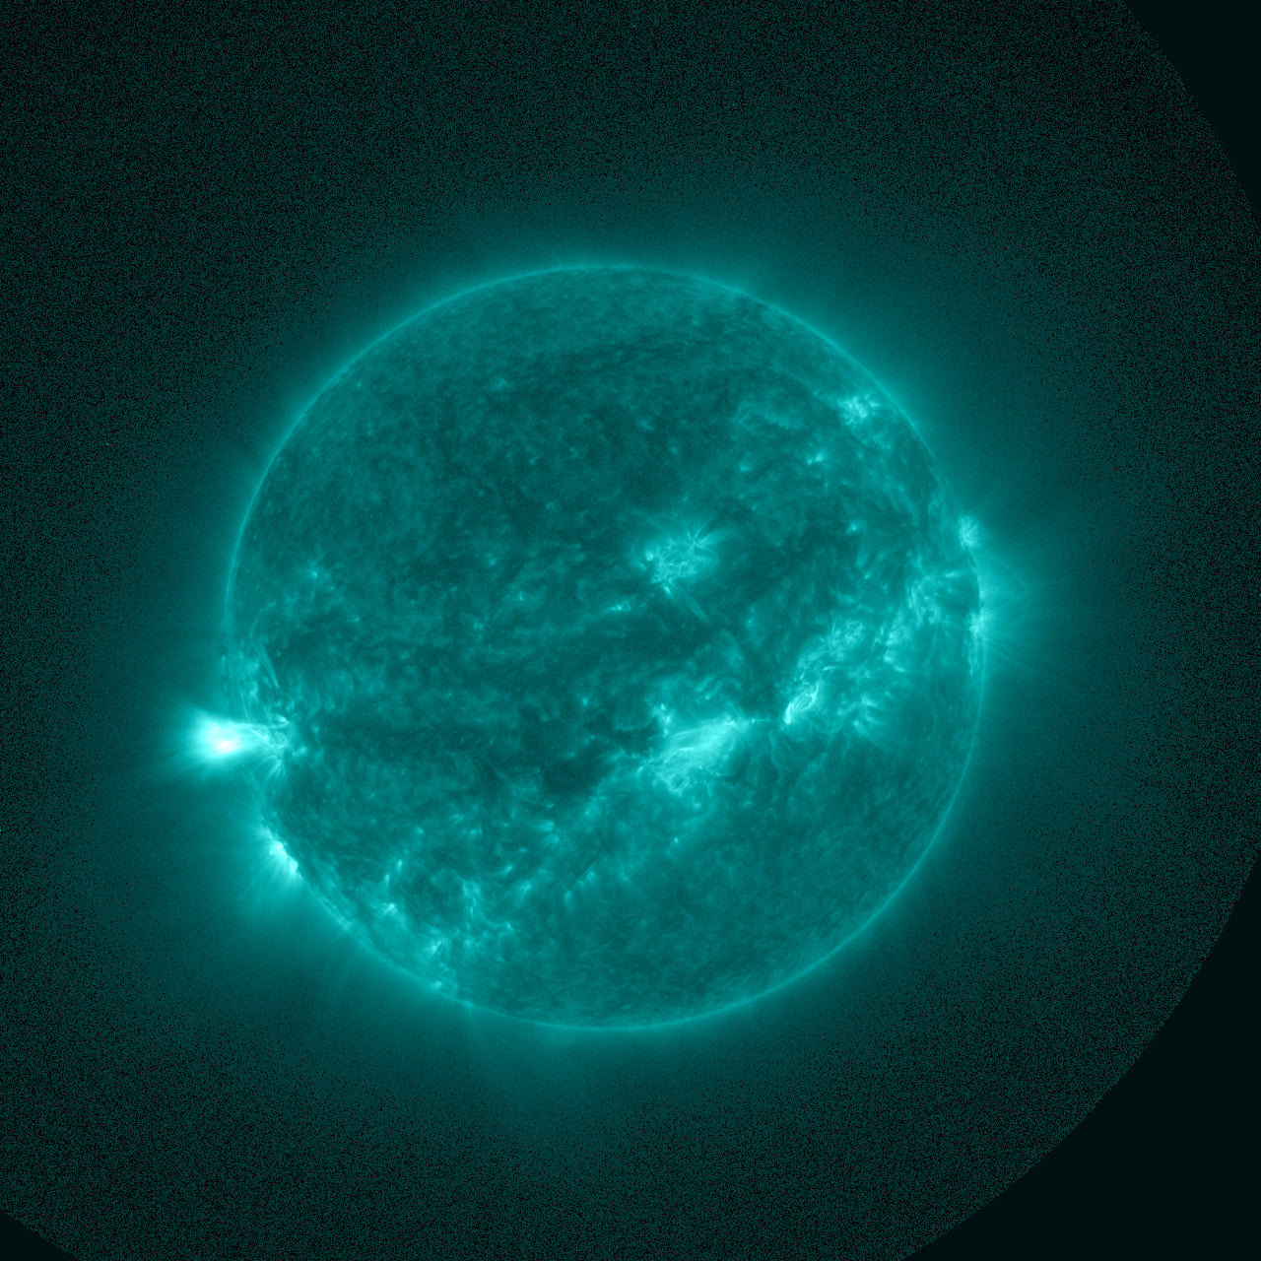
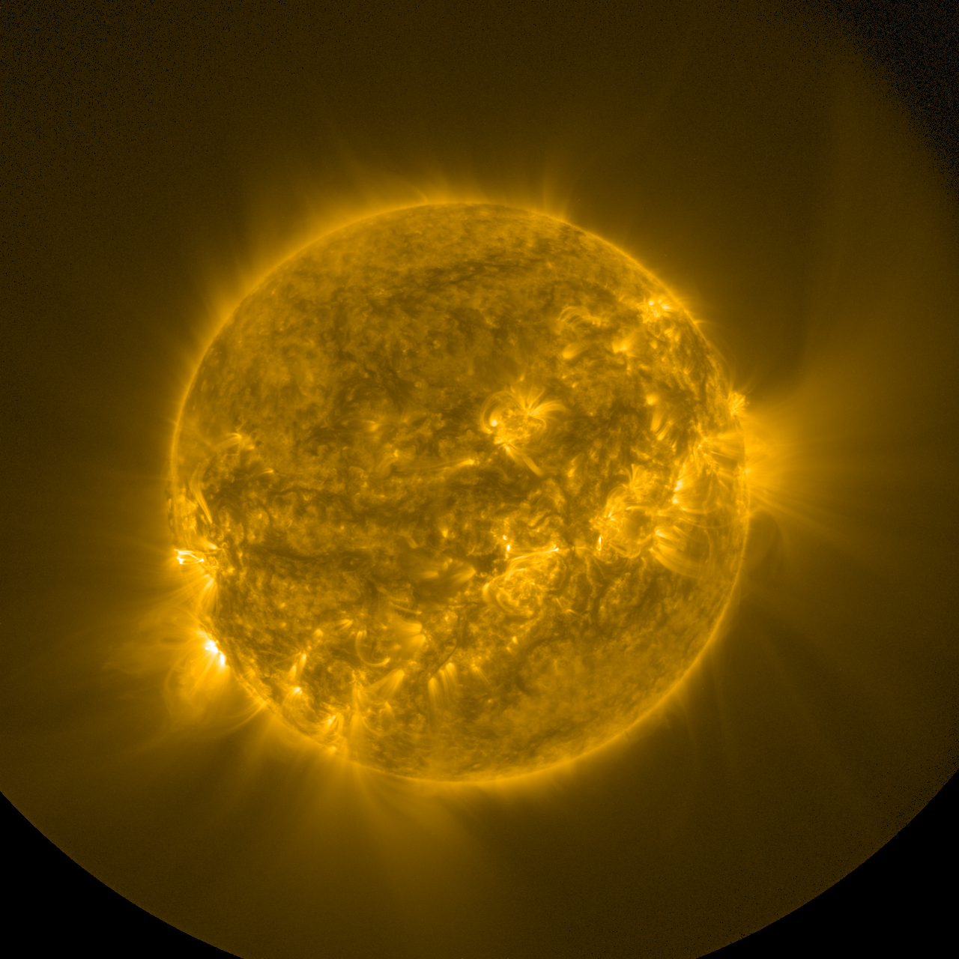
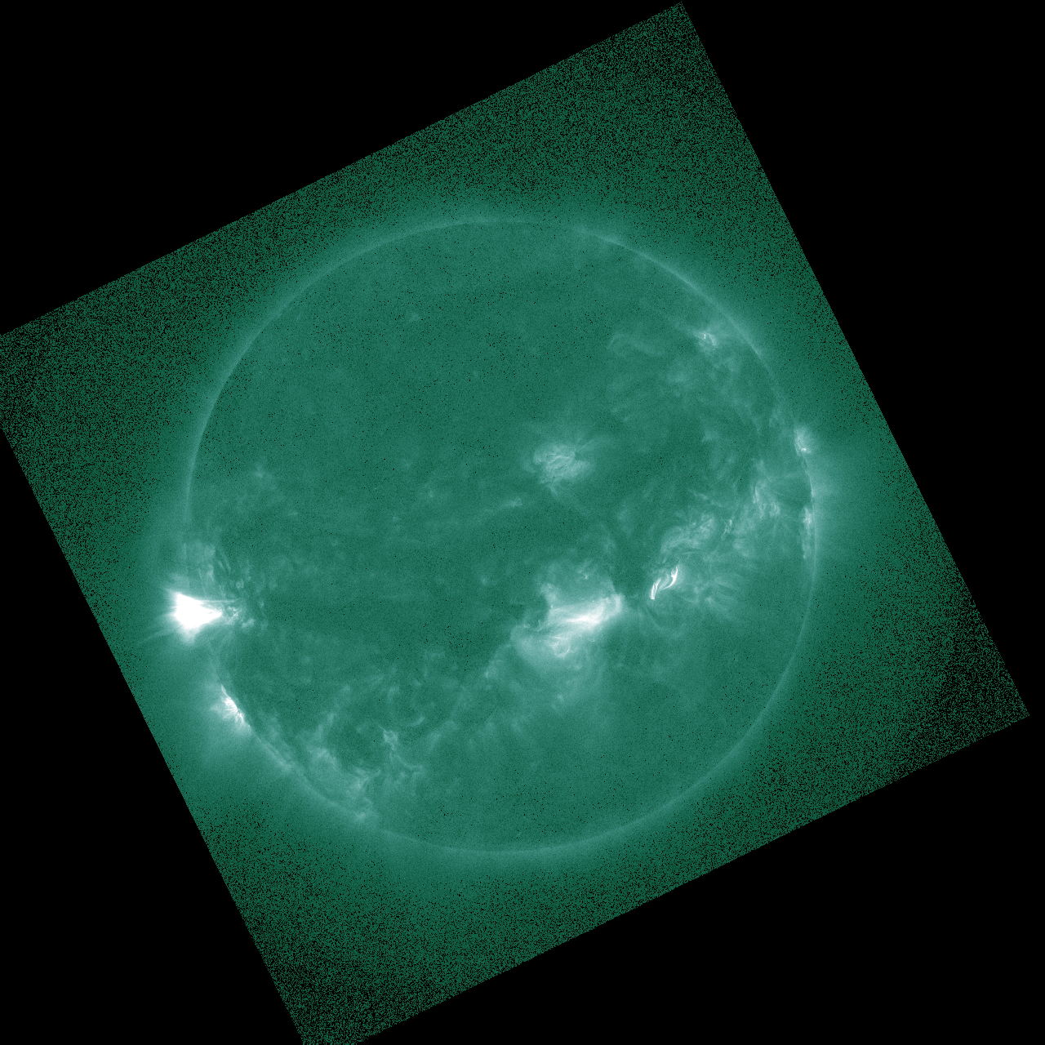
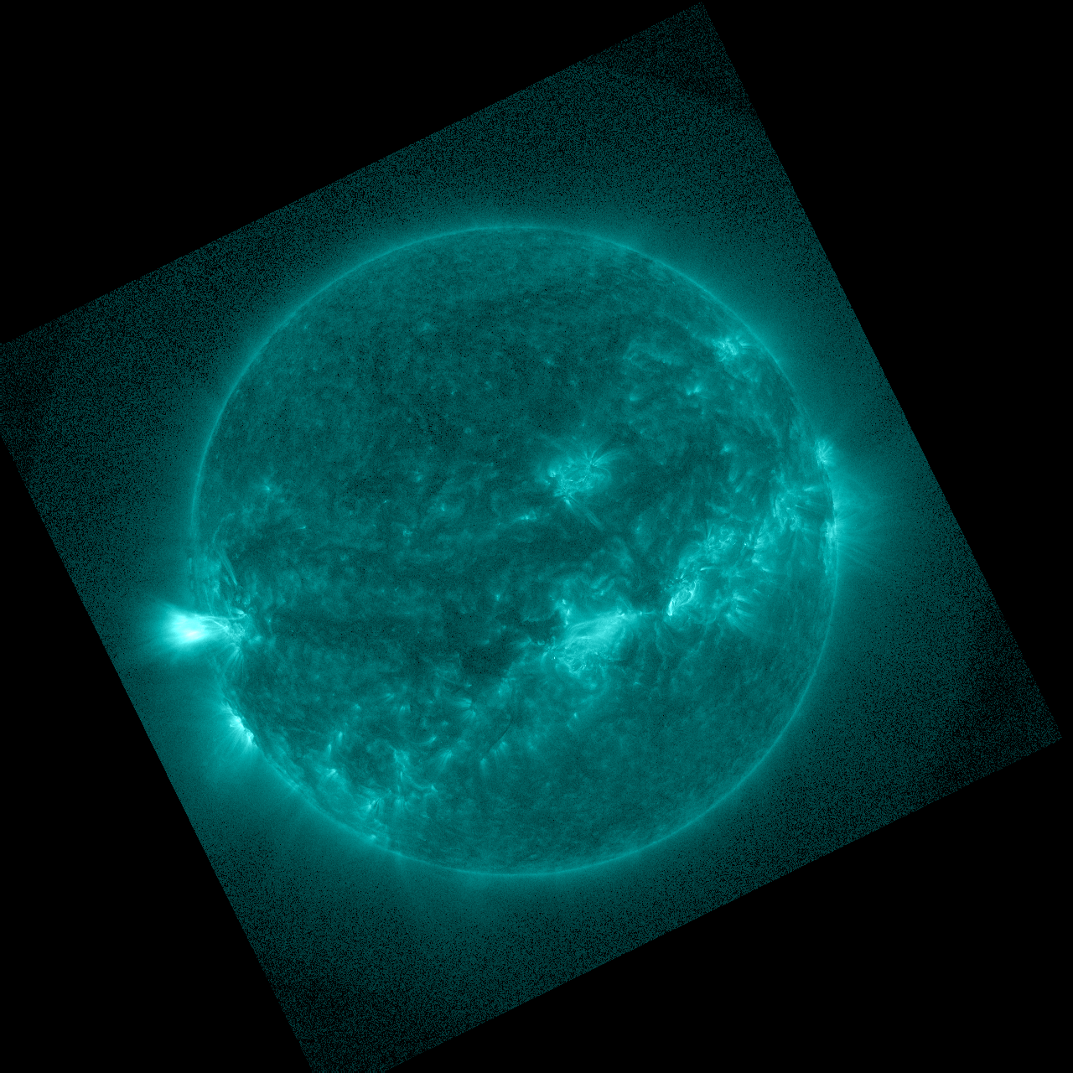
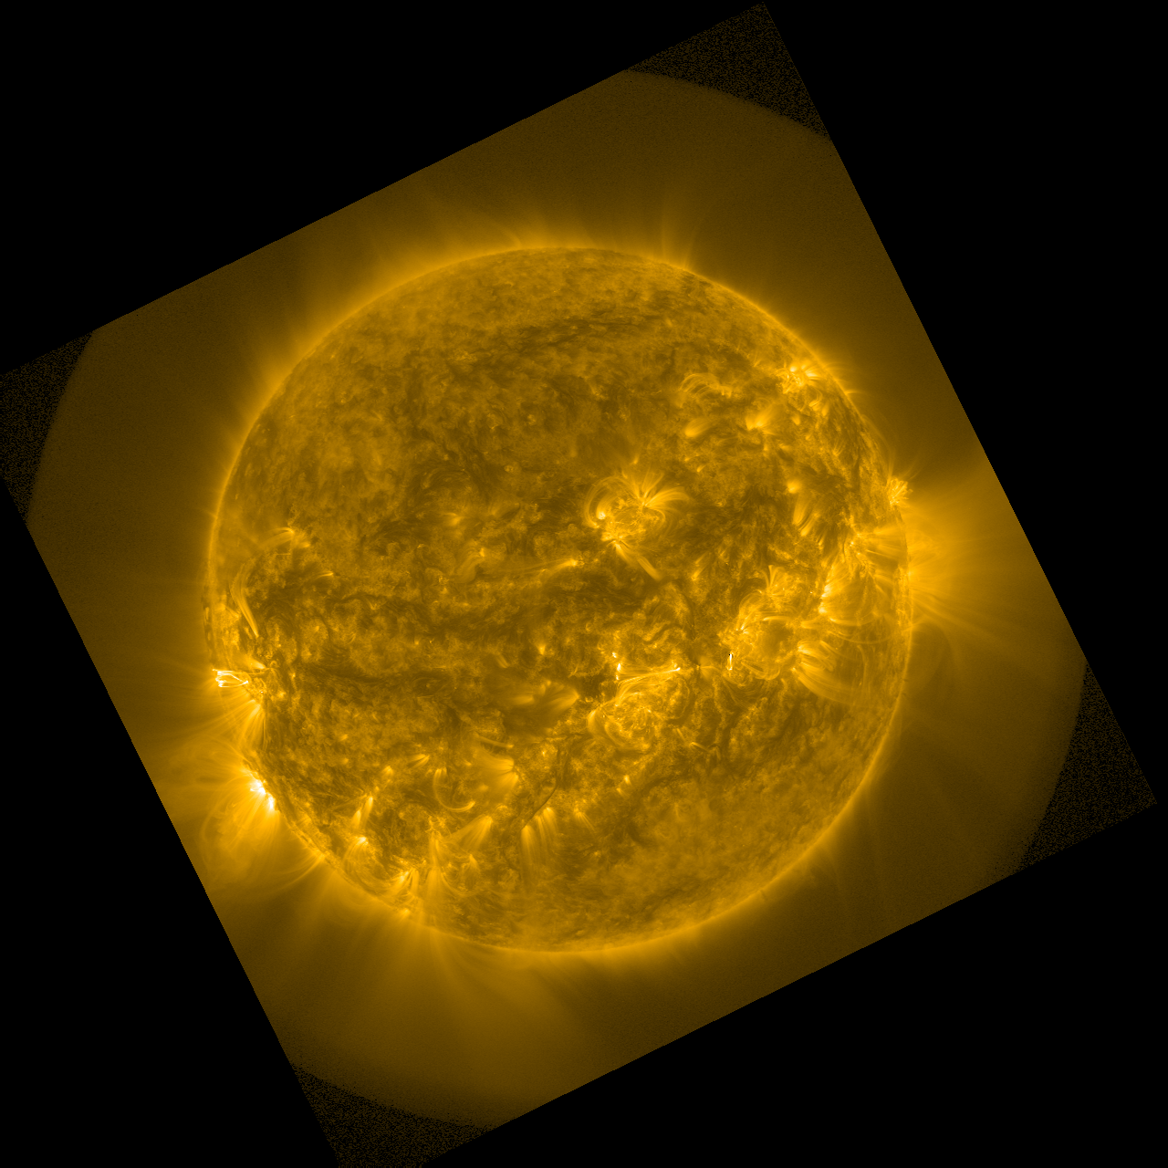
PLPT-SUVI-003: SUVI-AIA Intercalibration
94 Å
131 Å
171 Å
SUVI
3 Oct 2024 ~16:00 UT
94 Å
131 Å
171 Å
AIA

Slide 31
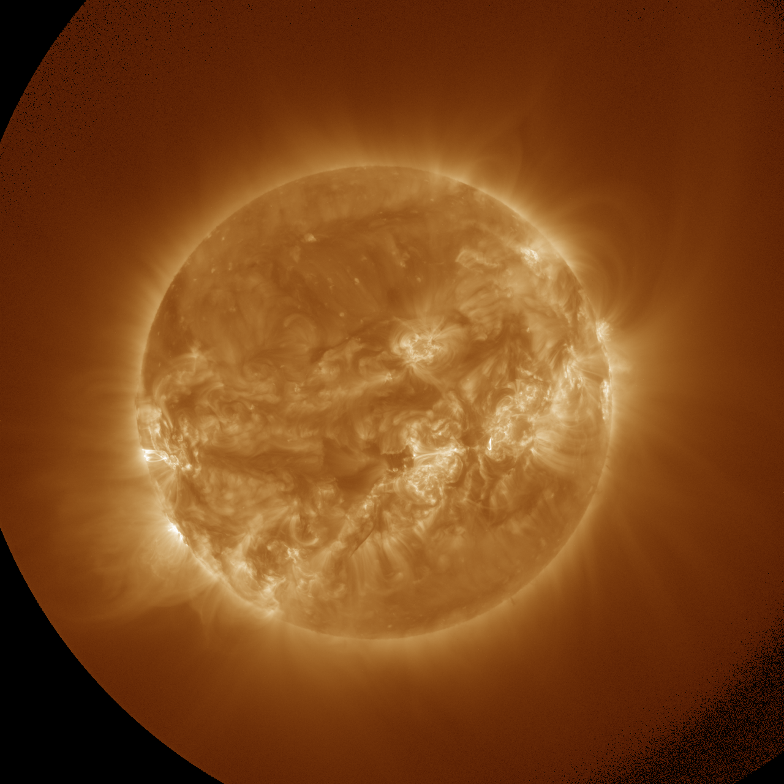
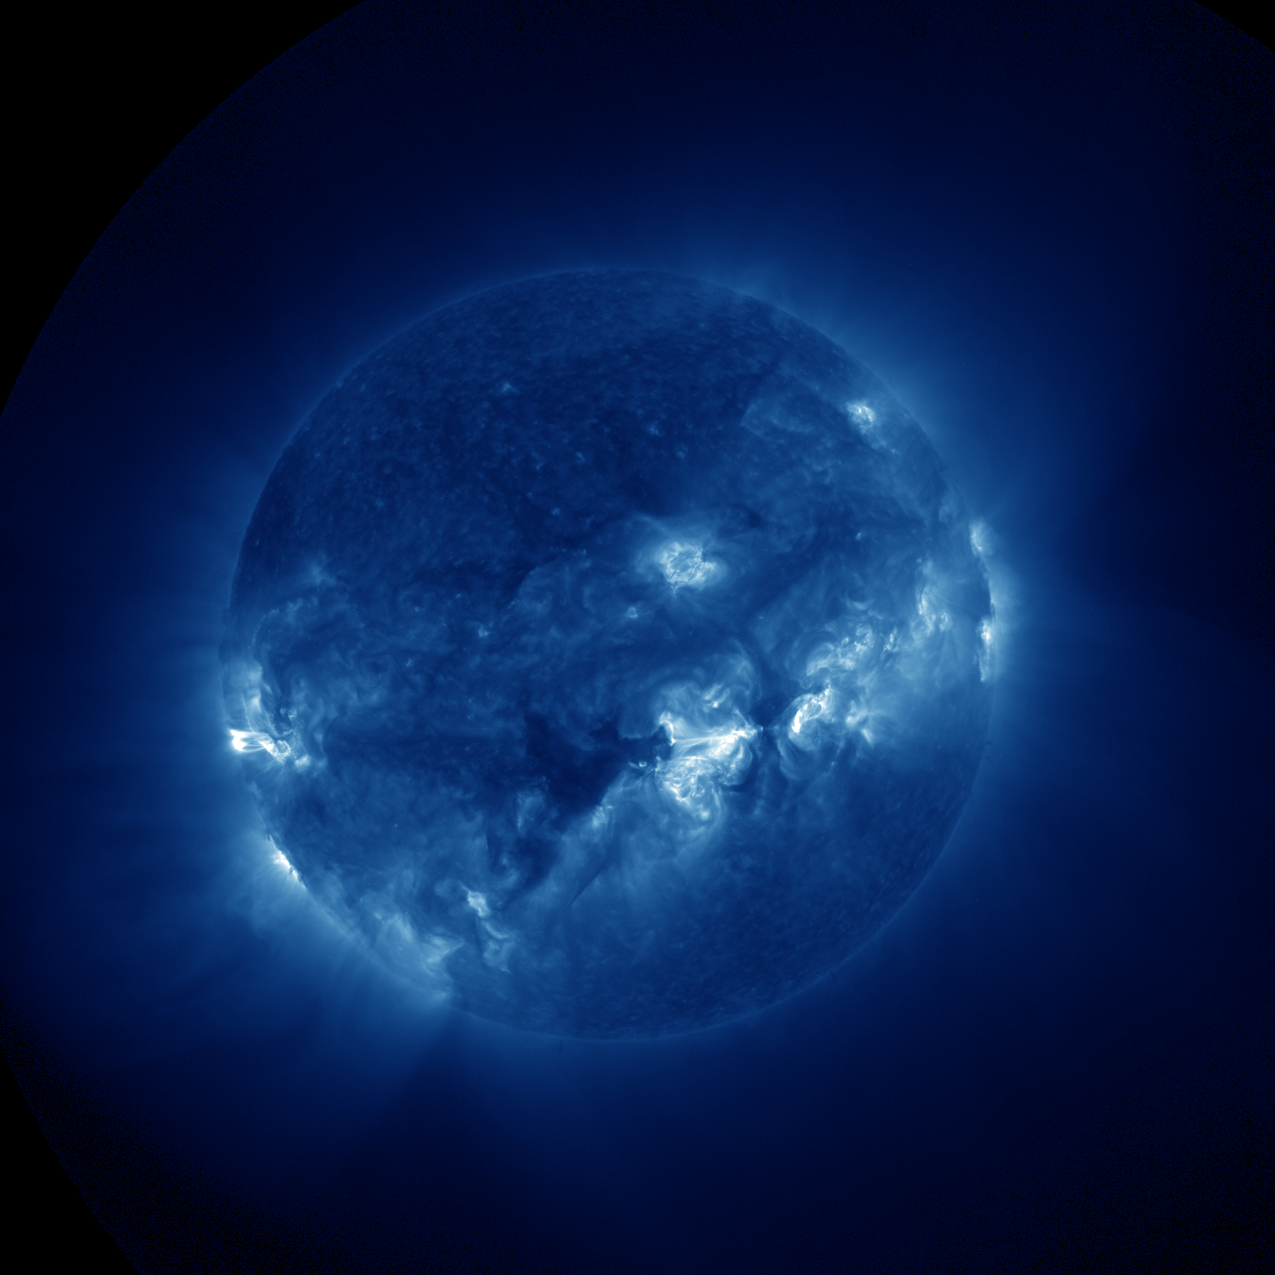
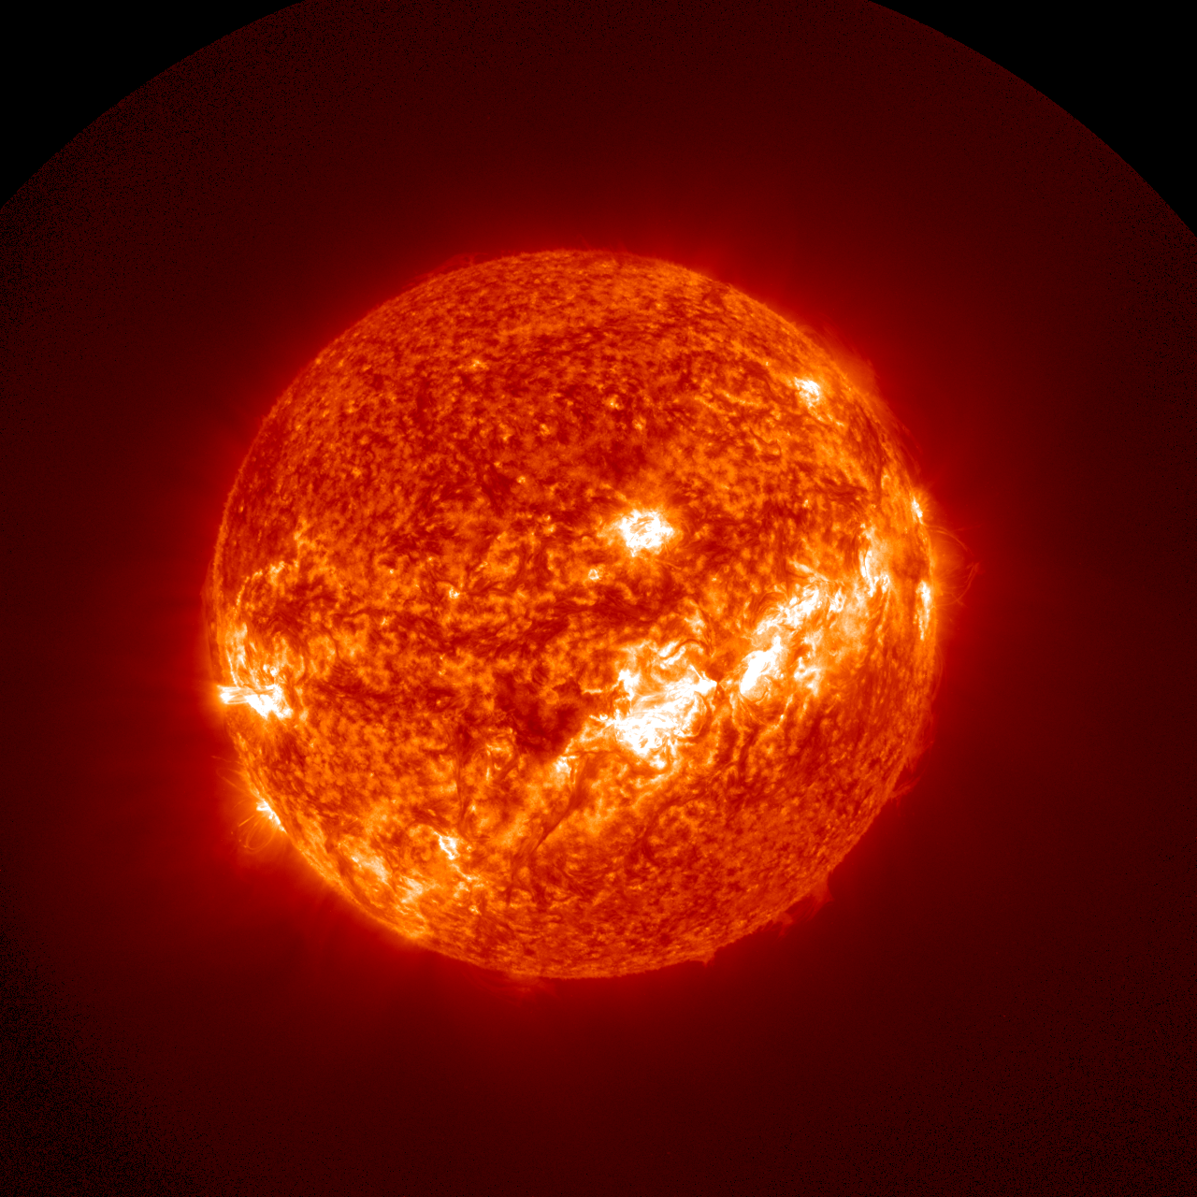
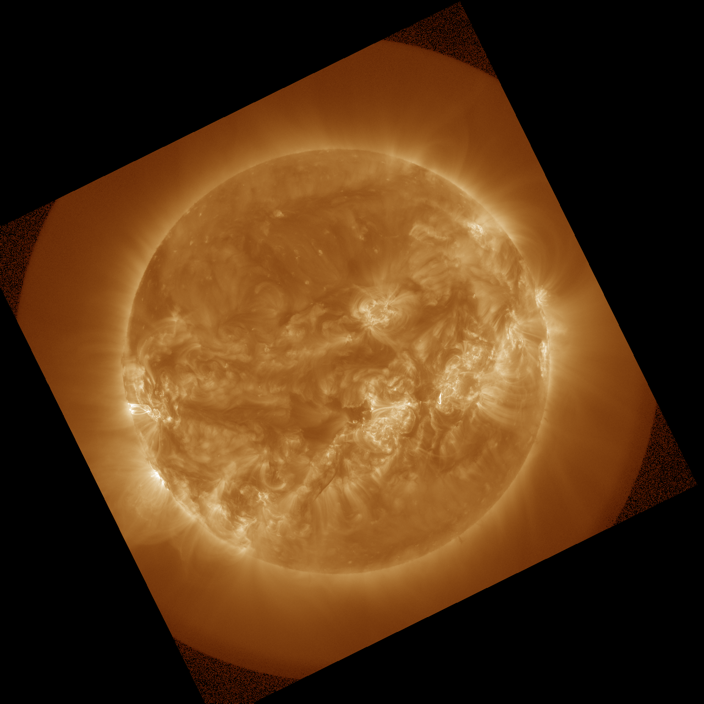
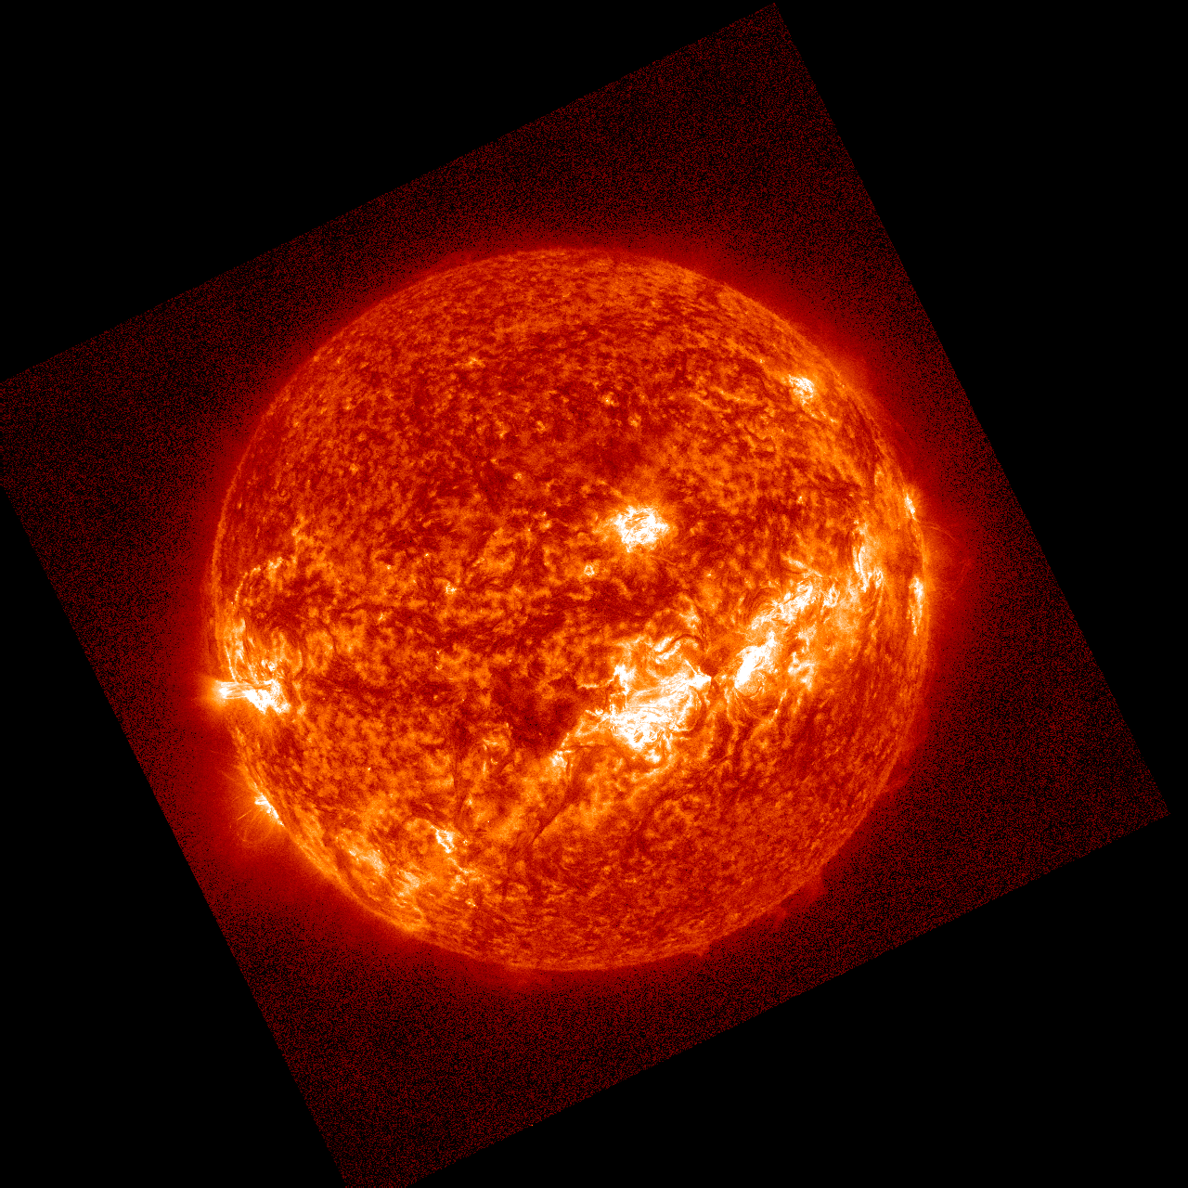
PLPT-SUVI-003: SUVI-AIA Intercalibration
195 Å
284 Å
304 Å
SUVI
3 Oct 2024 ~16:00 UT
193 Å
284 Å
304 Å
No corresponding AIA channel
AIA

Slide 32
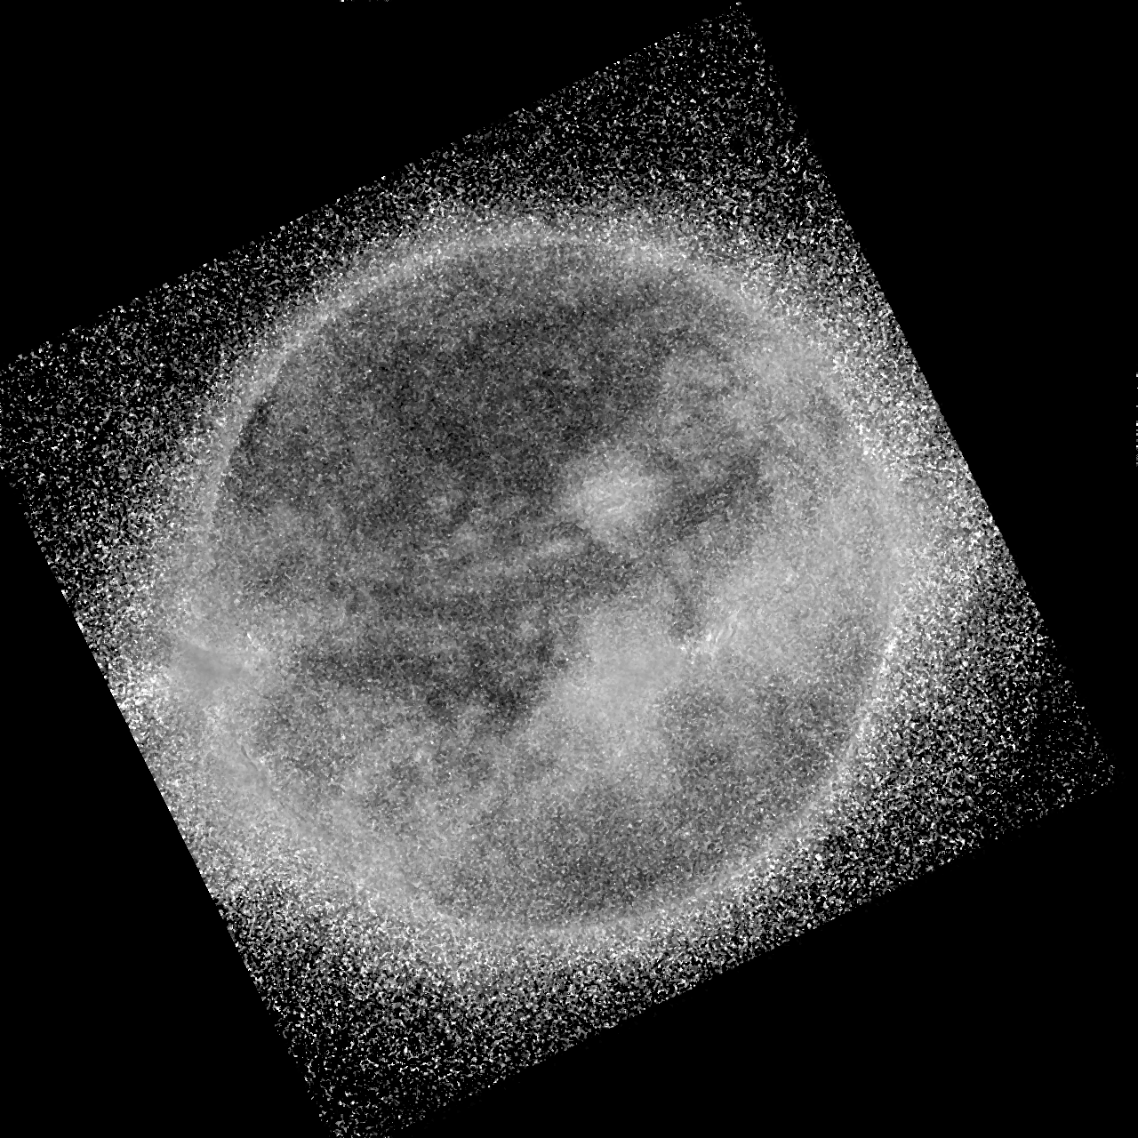
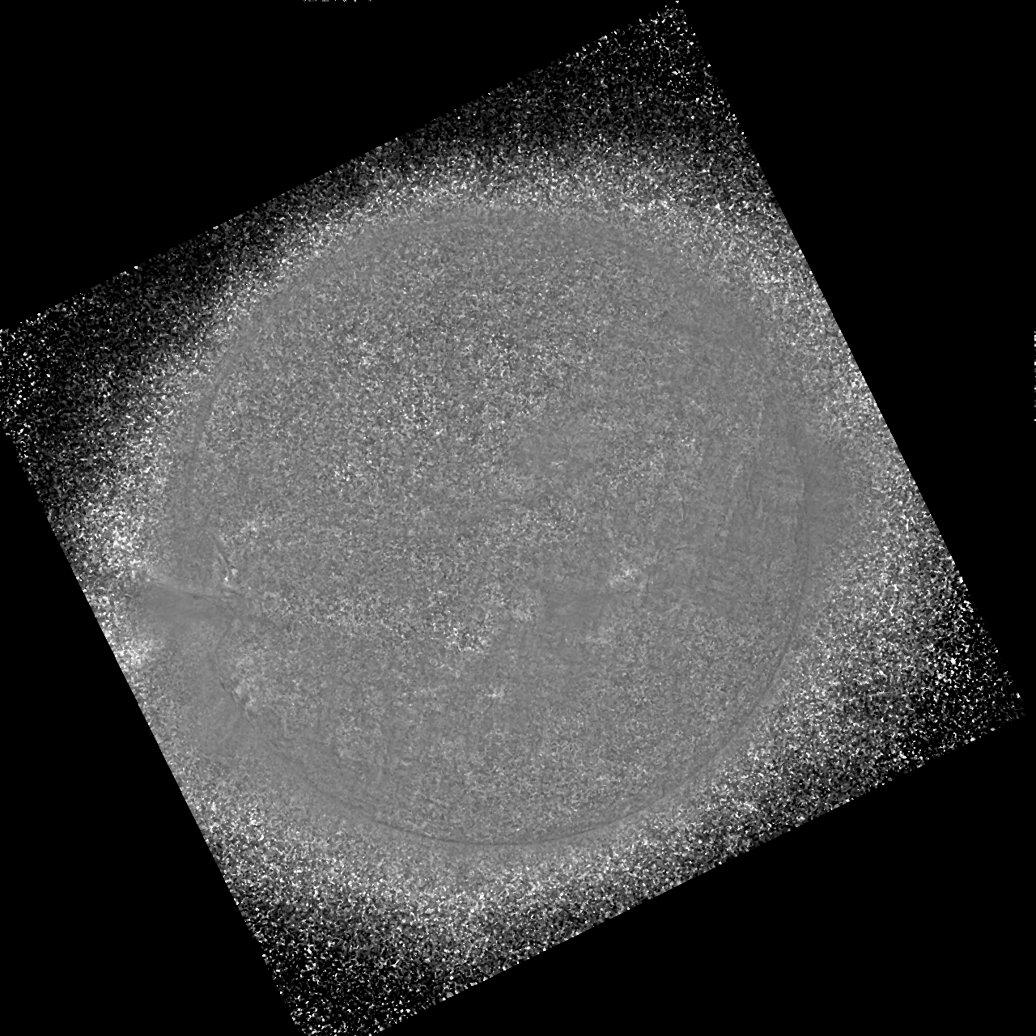
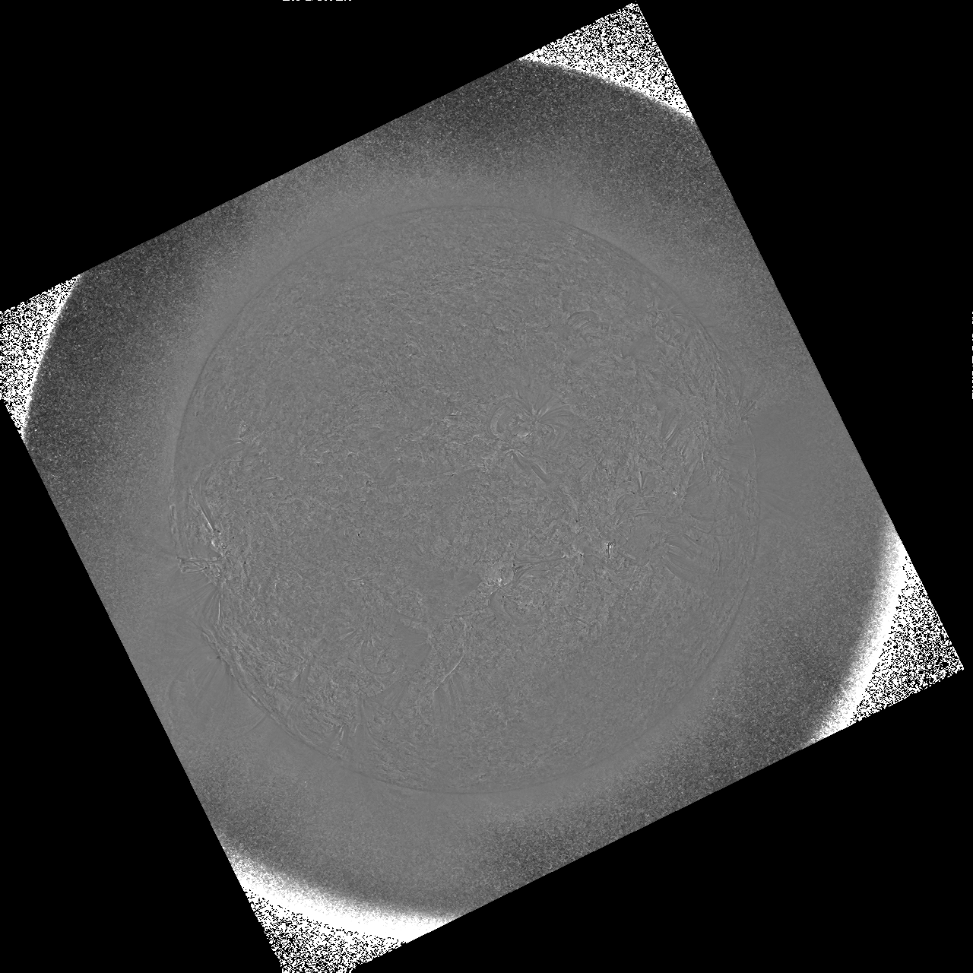
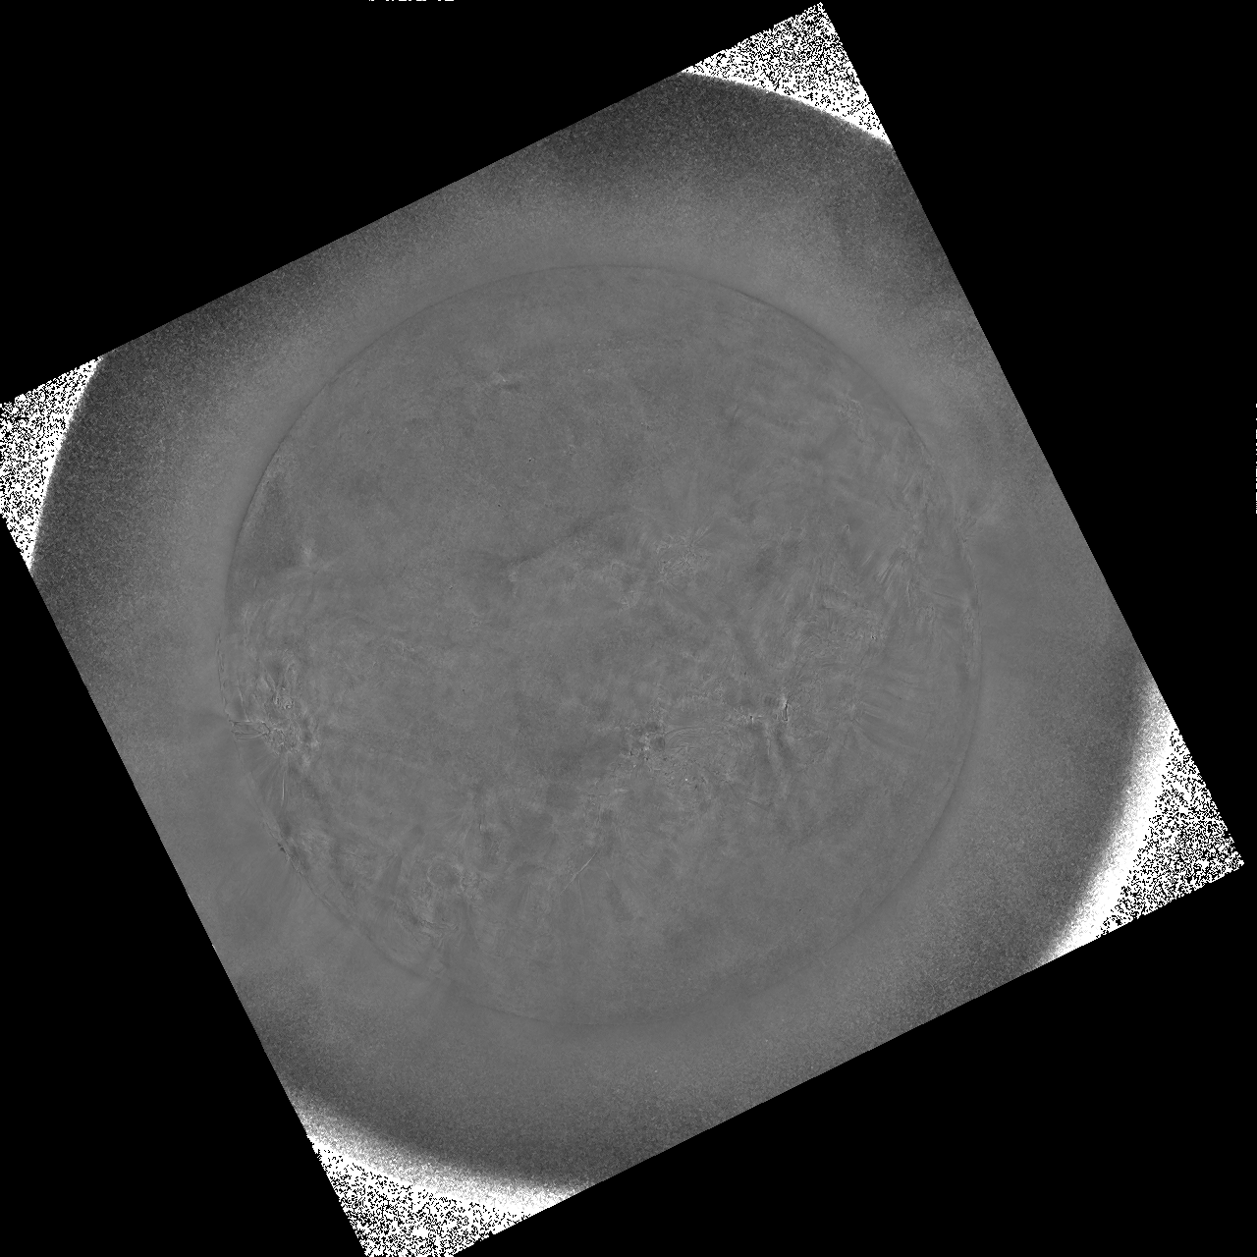
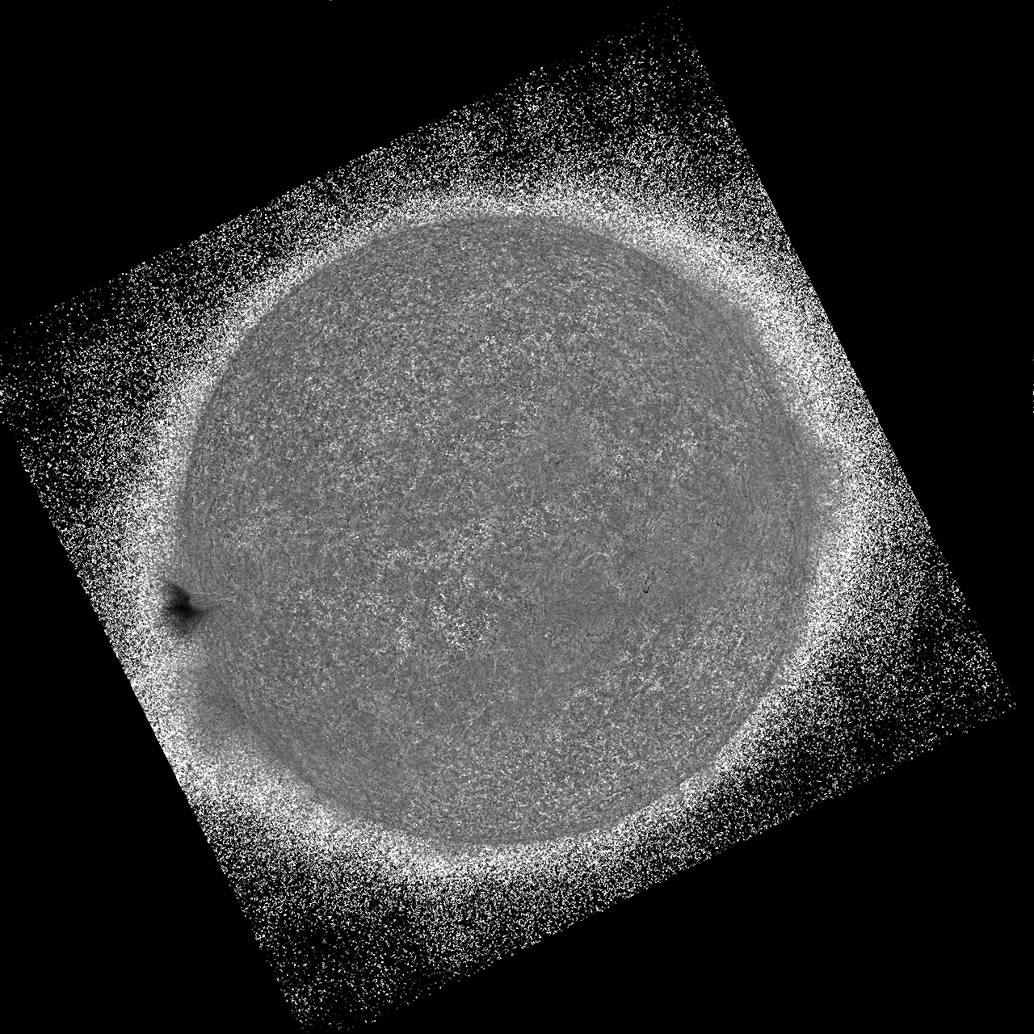
PLPT-SUVI-003: SUVI-AIA Intercalibration
94 Å
131 Å
171 Å
Ratio images
3 Oct 2024 ~16:00 UT
193 Å / 195 Å
284 Å
304 Å
No corresponding AIA channel

Slide 33
PLPT-SUVI-003: SUVI-AIA Intercalibration
How the following radiometric analysis is done:
Convolve EVE rocket spectra at a similar solar activity level (2014) with the SUVI and AIA responses expected ratio
Divide co-aligned and co-temporal SUVI and AIA images measured ratio
Note: due to the JSOC issues distributing recent SDO data, this analysis refers to data taken on 3 Oct 2024, before the GOES-19/SUVI data has been flatfielded, and before the throughputs have been updated.

Slide 34
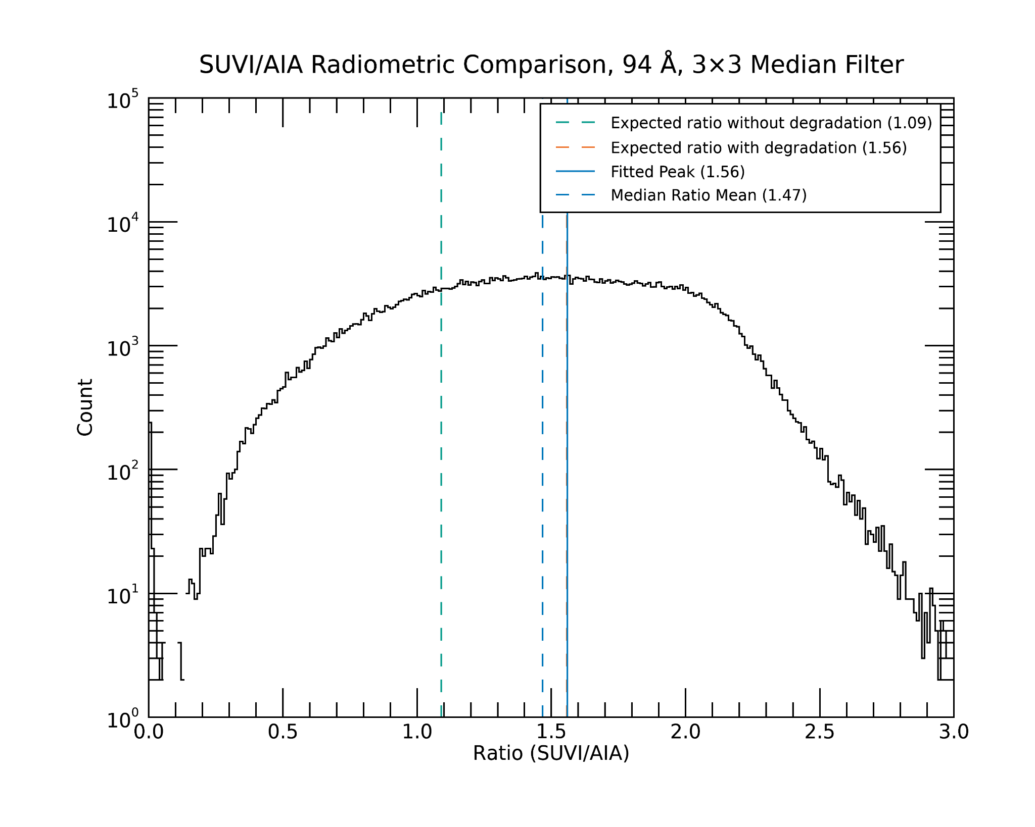
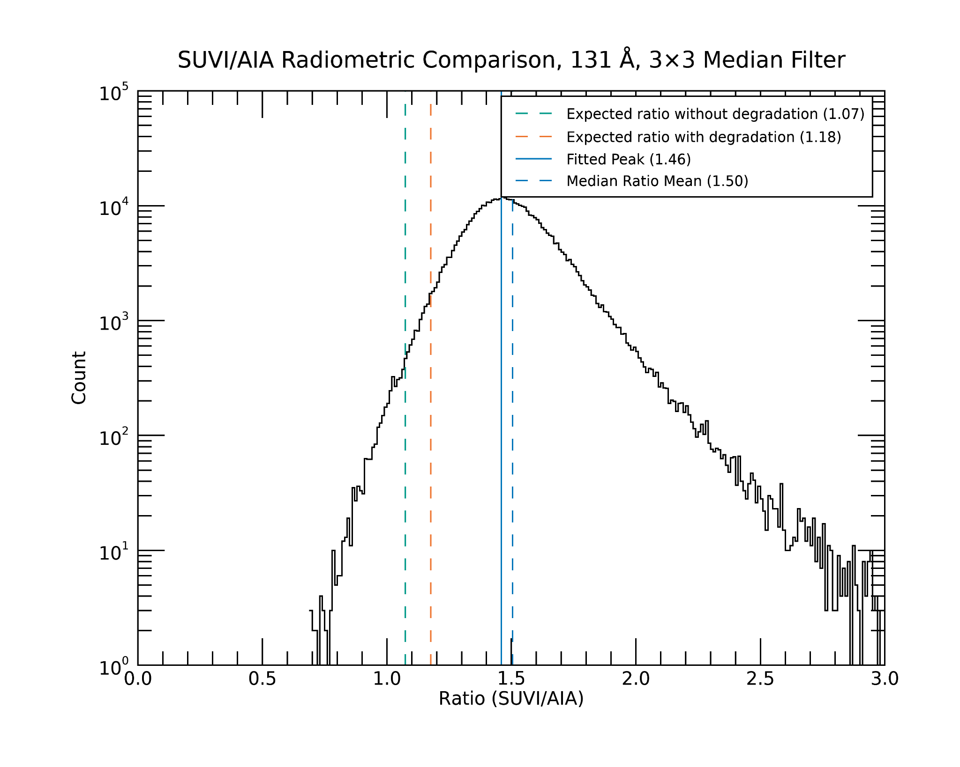
PLPT-SUVI-003: SUVI-AIA Intercalibration
Quick explanation for the plots:
- green dotted line: - orange dotted line: - blue lines (dotted and solid):
expected w/o degradation expected with degradation reality
94 Å
131 Å

Slide 35
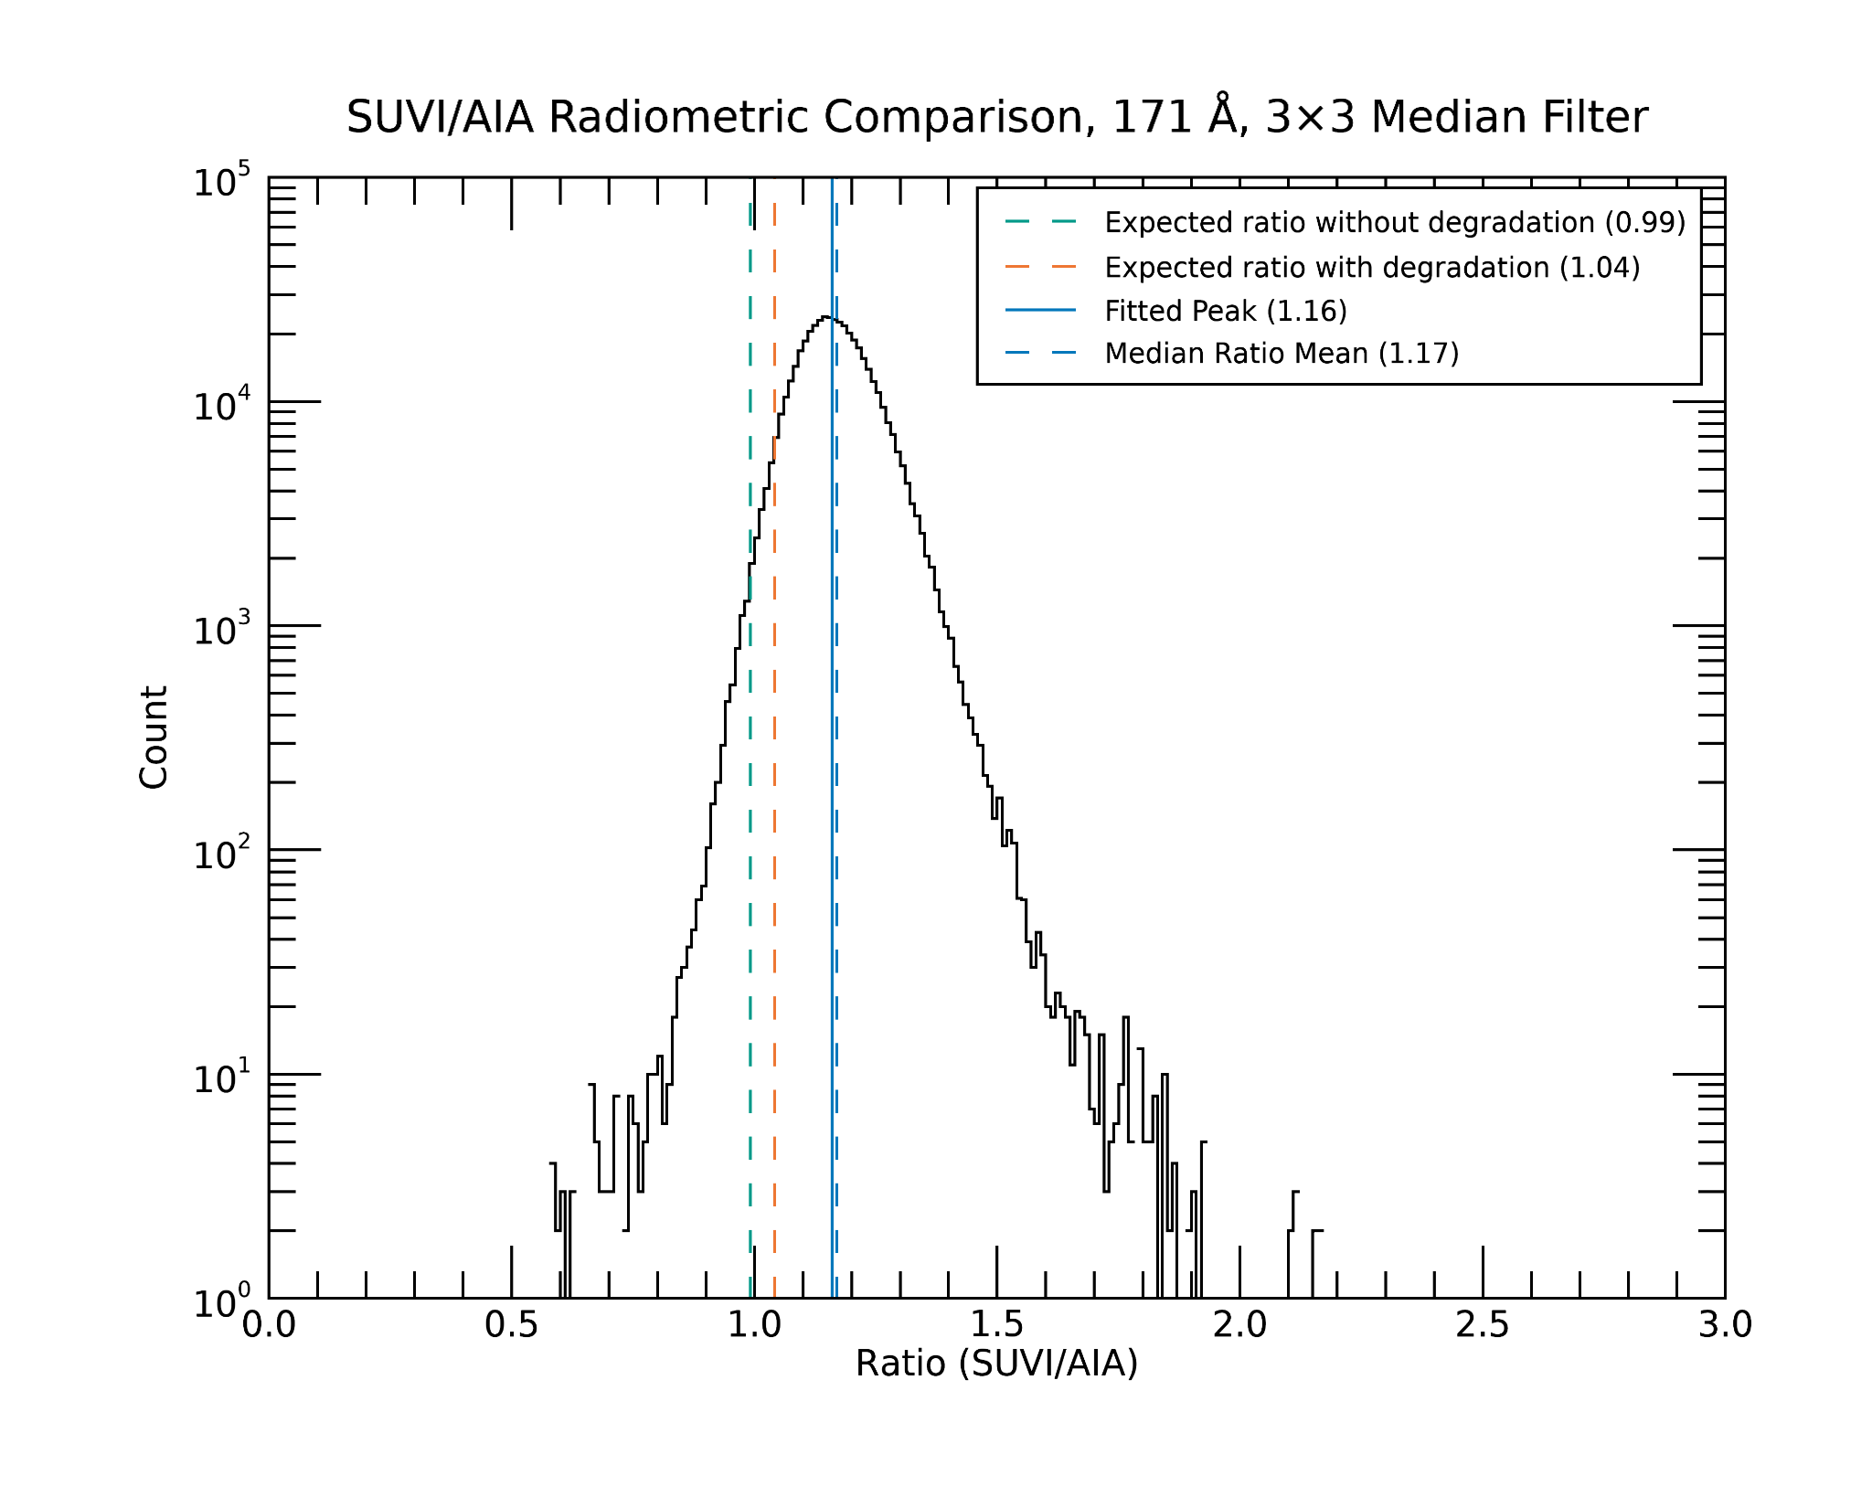
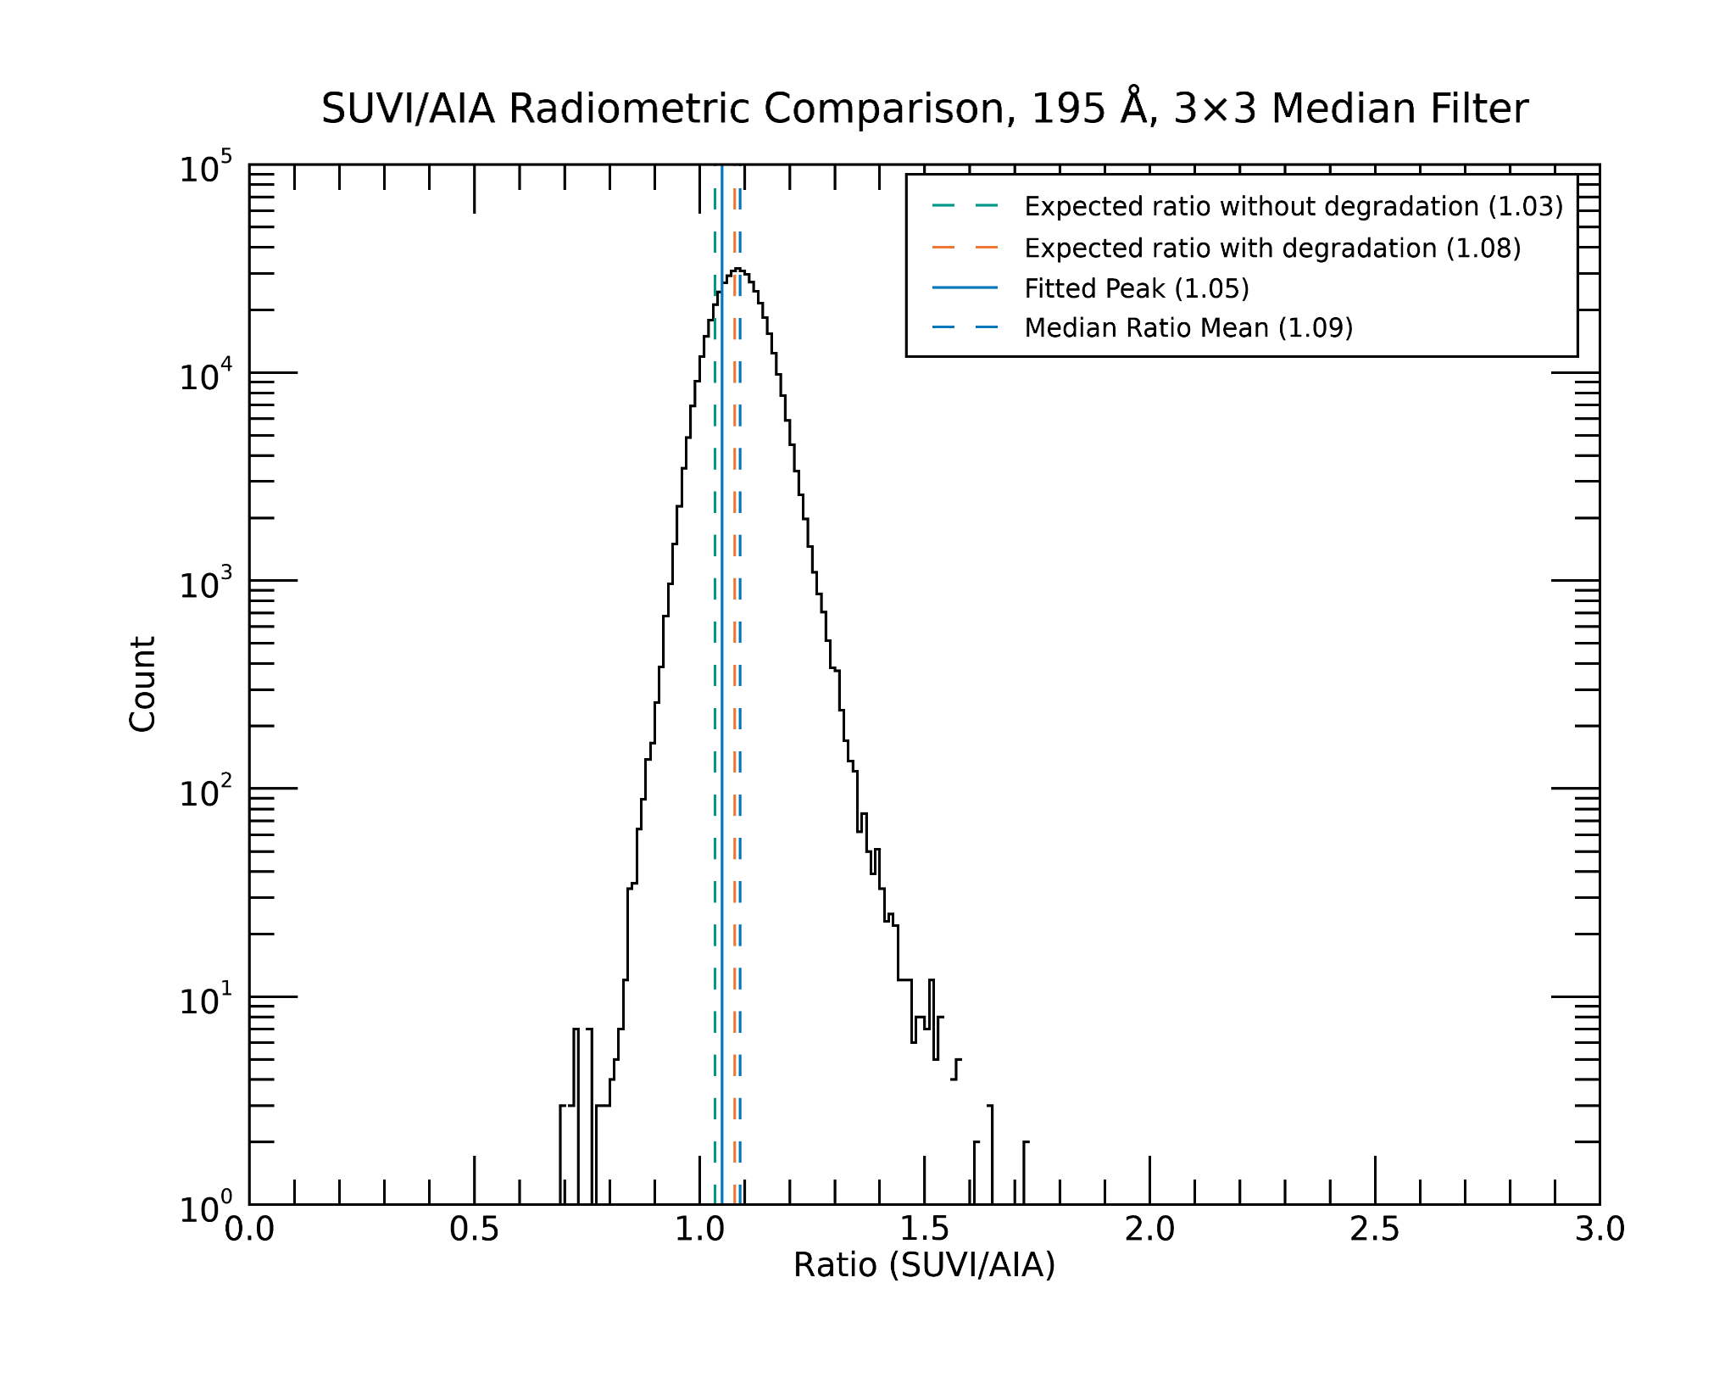
PLPT-SUVI-003: SUVI-AIA Intercalibration
Quick explanation for the plots:
- green dotted line: - orange dotted line: - blue lines (dotted and solid):
expected w/o degradation expected with degradation reality
171 Å
193 / 195 Å

Slide 36
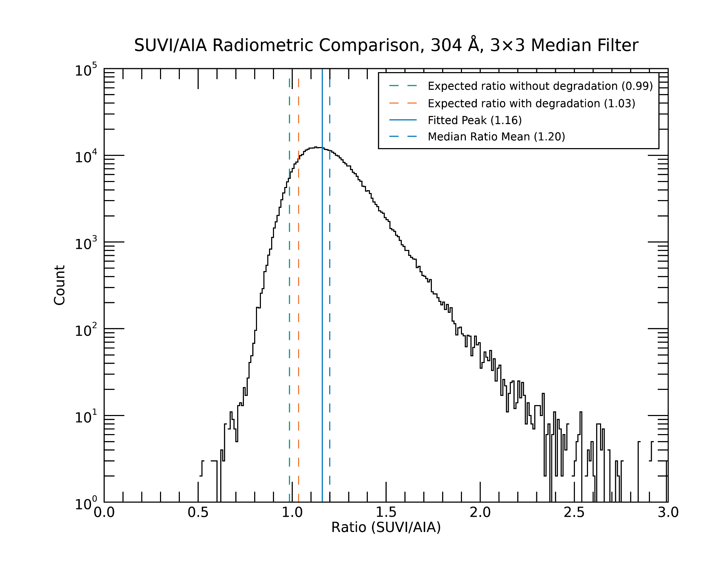
PLPT-SUVI-003: SUVI-AIA Intercalibration
Quick explanation for the plots:
- green dotted line: - orange dotted line: - blue lines (dotted and solid):
expected w/o degradation expected with degradation reality
304 Å

Slide 37
PLPT-SUVI-003: SUVI-AIA Intercalibration
Summary:
Ratio images show grid pattern from the filters in some channels due to the missing SUVI flatfields, otherwise pretty flat and nothing unexpected (some cloudiness due to passband differences between AIA and SUVI).
Radiometry differences within expected margins for most channels, with the exception of 131 Å (1.18 vs 1.46). Maybe this will change with the updated throughputs for SUVI.

Slide 38
PLPT-SUVI-003: SUVI-AIA Intercalibration
There is no standard candle for EUV observations to quantify absolute degradation; comparison to AIA provides an estimate of long term degradation.
The following plots show the ratio of SUVI and AIA mean image irradiance for all comparable channels and relevant SUVI instruments. Note that since the units of AIA measurements differ from SUVI, the expected value of this ratio is not one.
SUVI-16 and SUVI-18 trends are shown from Jan 1 2024 - Jan 30 2025 for reference.
Quality SUVI-19 data was available on-prem starting in early September 2024.
SUVI-19 has undergone multiple phases of Extended Coronal Imagining (ECI) testing during the provisional validation period, and therefore has data outages from 22-25 Oct 2024 and 16-30 Jan 2025.
For SUVI-19 provisional, jumps due to LUT updates and/or bakeouts are not corrected. However, for SUVI-16 and SUVI-18 corrections for these features are applied.
Conclusions: SUVI-19 degraded a non-negligible amount (greater than 4% in all channels) relative to AIA during the period from early September 2024 - late January 2025. The greatest amount of degradation was observed in the 94 Å channel.

Slide 39
PLPT-SUVI-003: SUVI-AIA Intercalibration
Reminder:
There is no standard candle for EUV observations to quantify absolute degradation; comparison to AIA provides an estimate of long term degradation.
Degradation is very hard to disentangle from response function differences and solar activity
The following plots show the ratio of SUVI and AIA mean image irradiance for all comparable channels and relevant SUVI instruments. Note that since the units of AIA measurements differ from SUVI, the expected value of this ratio is not one.
SUVI-16 and SUVI-18 trends are shown from Jan 1 2024 - Jan 30 2025 for reference.
Quality SUVI-19 data was available on-prem starting in early September 2024.
SUVI-19 has undergone multiple phases of Extended Coronal Imagining (ECI) testing during the provisional validation period, and therefore has data outages from 22-25 Oct 2024 and 16-30 Jan 2025.
For SUVI-19 provisional, jumps due to LUT updates and/or bakeouts are not corrected. However, for SUVI-16 and SUVI-18 corrections for these features are applied.

Slide 40
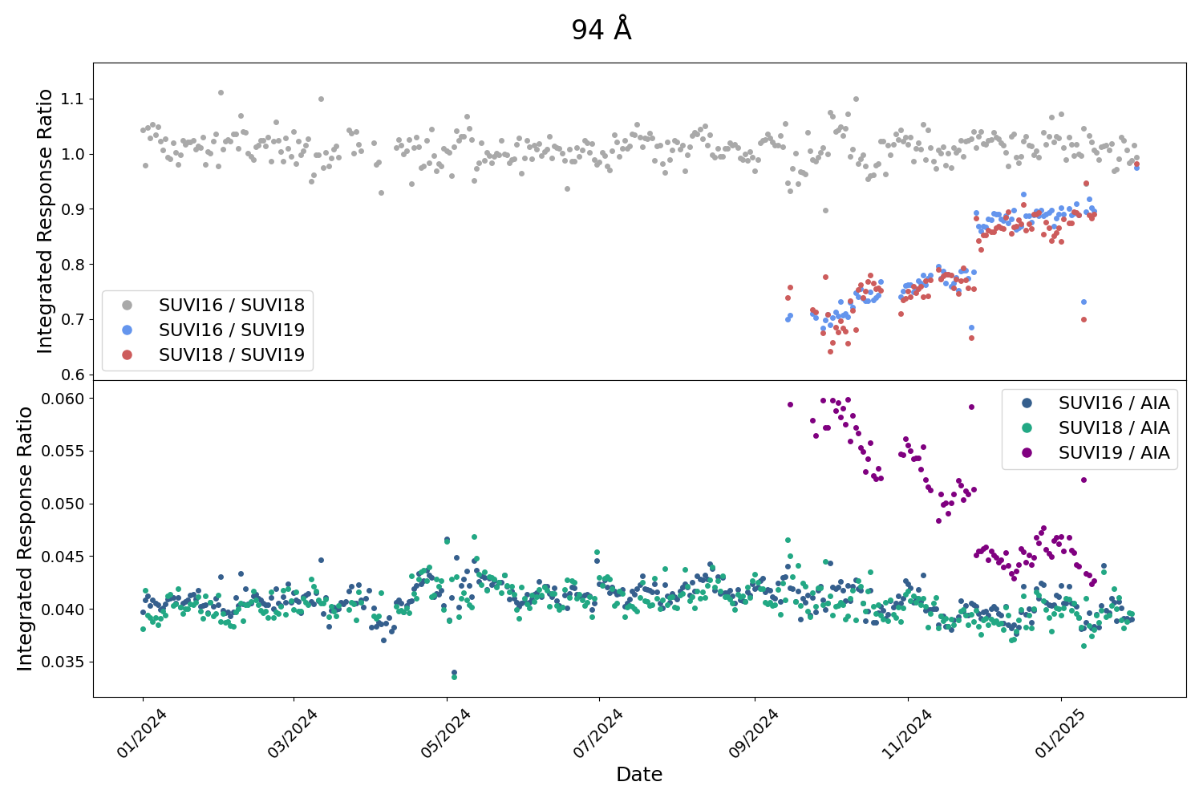
PLPT-SUVI-003: SUVI-AIA Intercalibration
SUVI 94 Å
AIA and SUVI have different saturation thresholds in 94 Å, resulting in high variance in their ratio during periods of solar activity.
Approximately 30% degradation in SUVI-19 94 Å relative to AIA
Similar degradation observed relative to SUVI-16 and 18

Slide 41
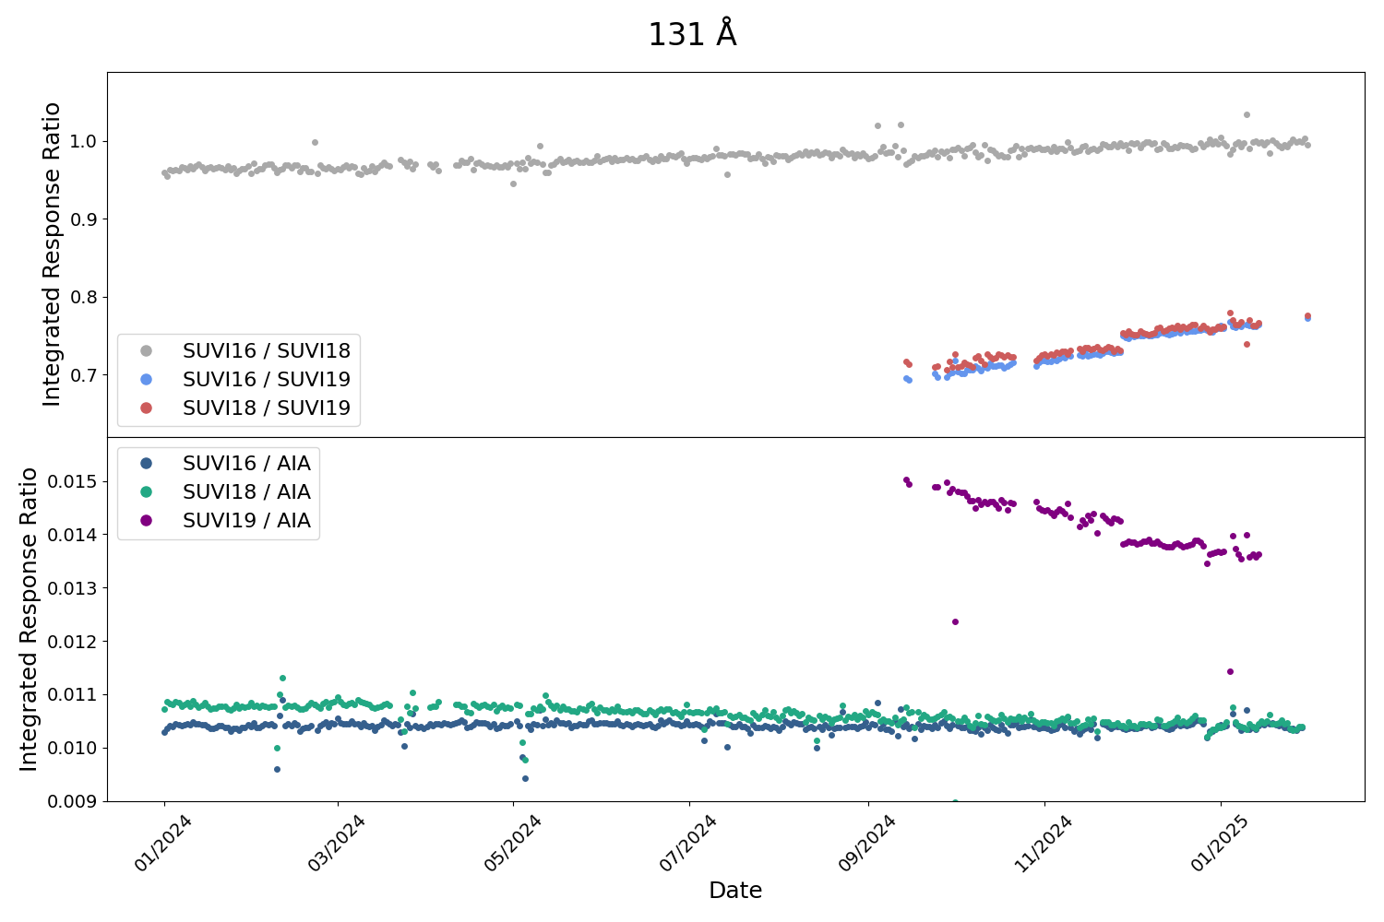
PLPT-SUVI-003: SUVI-AIA Intercalibration
SUVI 131 Å
Approximately 9% degradation in SUVI-19 131 Å relative to AIA
Similar degradation observed relative to SUVI-16 and 18

Slide 42
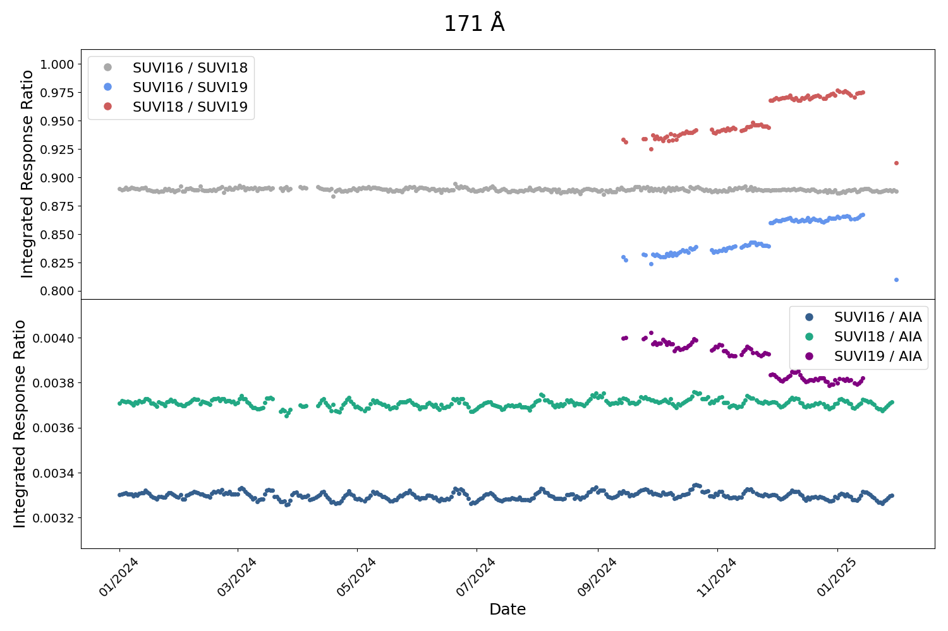
PLPT-SUVI-003: SUVI-AIA Intercalibration
SUVI 171 Å
Approximately 5% degradation in SUVI-19 171Å relative to AIA
Similar degradation observed relative to SUVI-16 and 18

Slide 43
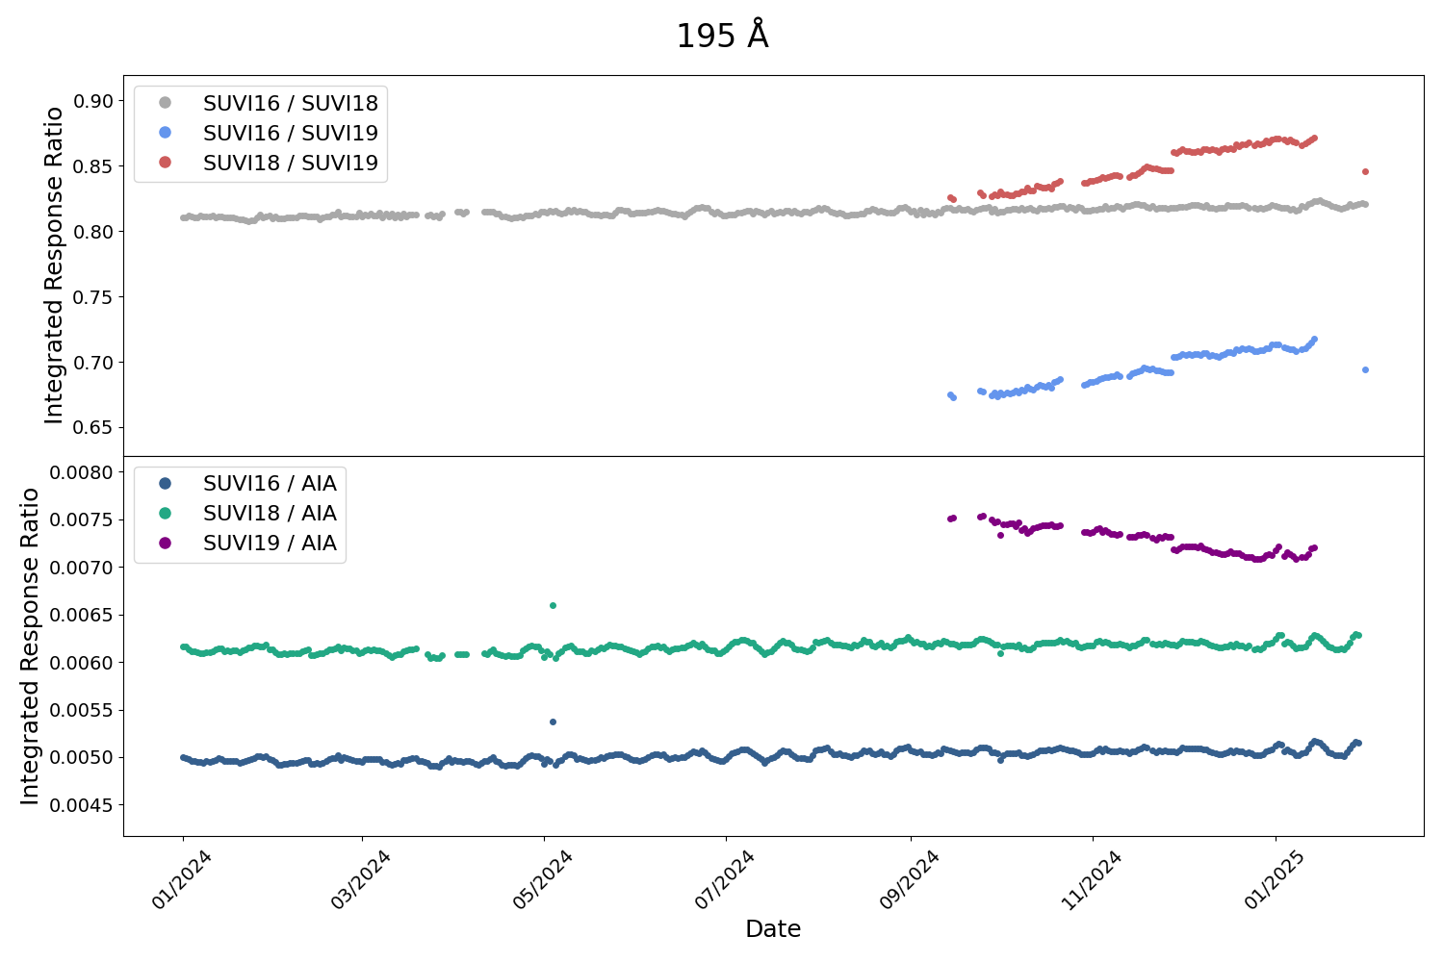
PLPT-SUVI-003: SUVI-AIA Intercalibration
SUVI 195 Å
Approximately 4% degradation in SUVI-19 195 Å relative to AIA
Note that spectral response is slightly different in this channel for SUVI vs AIA, therefore some solar activity is preserved in the trends

Slide 44
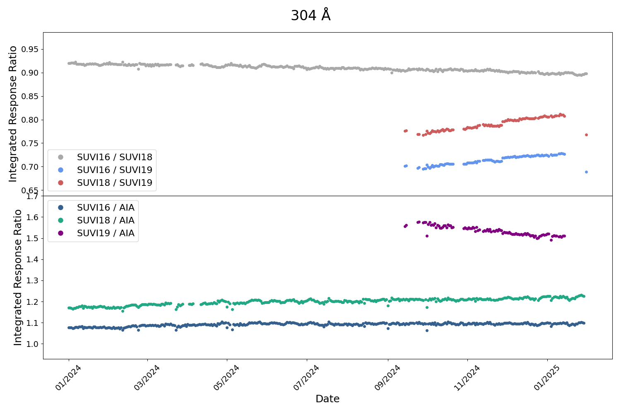
PLPT-SUVI-003: SUVI-AIA Intercalibration
SUVI 304 Å
Approximately 5% degradation in SUVI-19 304 Å relative to AIA
Similar degradation observed relative to SUVI-16 and 18

Slide 45
PLPT SUVI-003: SUVI-AIA Intercomparison
Summary:
GOES-19/SUVI degraded a non-negligible amount (greater than 4% in all channels) relative to AIA during the period from early September 2024 until late January 2025. The greatest amount of degradation was observed in the 94 Å channel (~30 %).
The steep degradation at the beginning of the mission is expected and is consistent with previous missions. It is expected that the degradation slowly levels off from now on, which should be easier to assess in the future as solar activity decreases.

Slide 46
PLPT SUVI-007: SUVI-SUVI Intercomparison
Straight comparison between respective SUVI Instruments
Current instruments are the GOES-16/18/19 SUVI instruments
GOES-17 SUVI has known light leaks in the 94Å channel
GOES-16 SUVI has a known light leak in the 94Å channel
GOES-16 SUVI now uses the Thick-Zr filter to mitigate the light leak
Comparisons between SUVI instruments illuminate the unknowns of instrument performance between the different flight models.

Slide 47
PLPT SUVI-007: SUVI-SUVI Intercomparison
How the following radiometric analysis is done:
Convolve EVE rocket spectra at a similar solar activity level (2014) with the SUVI responses from different flight models expected ratio
Divide co-aligned and co-temporal SUVI images from different flight models measured ratio

Slide 48
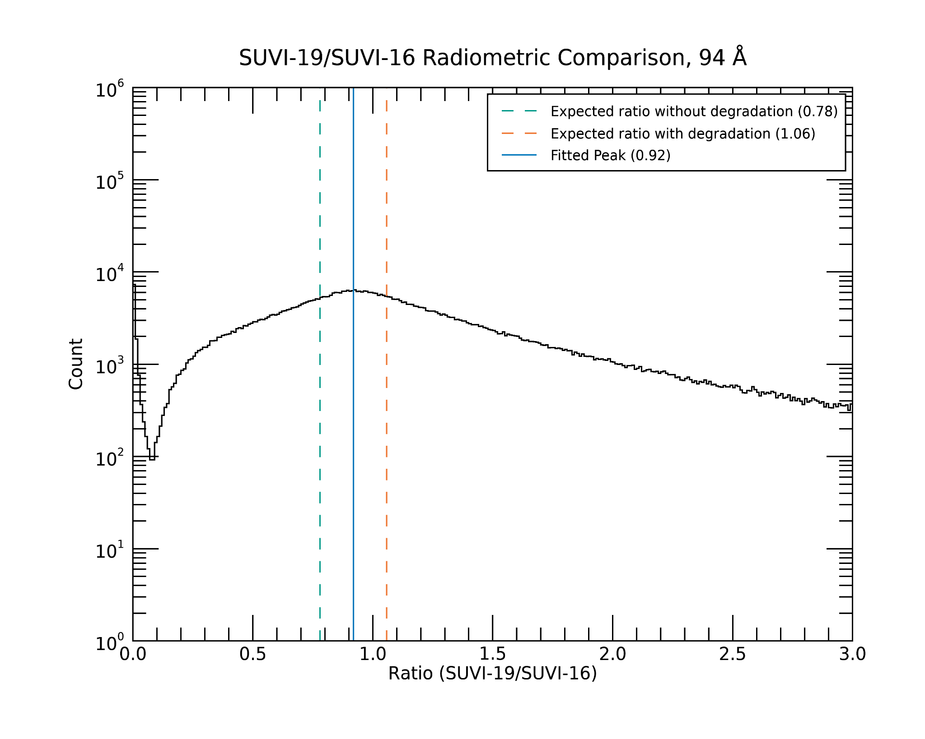
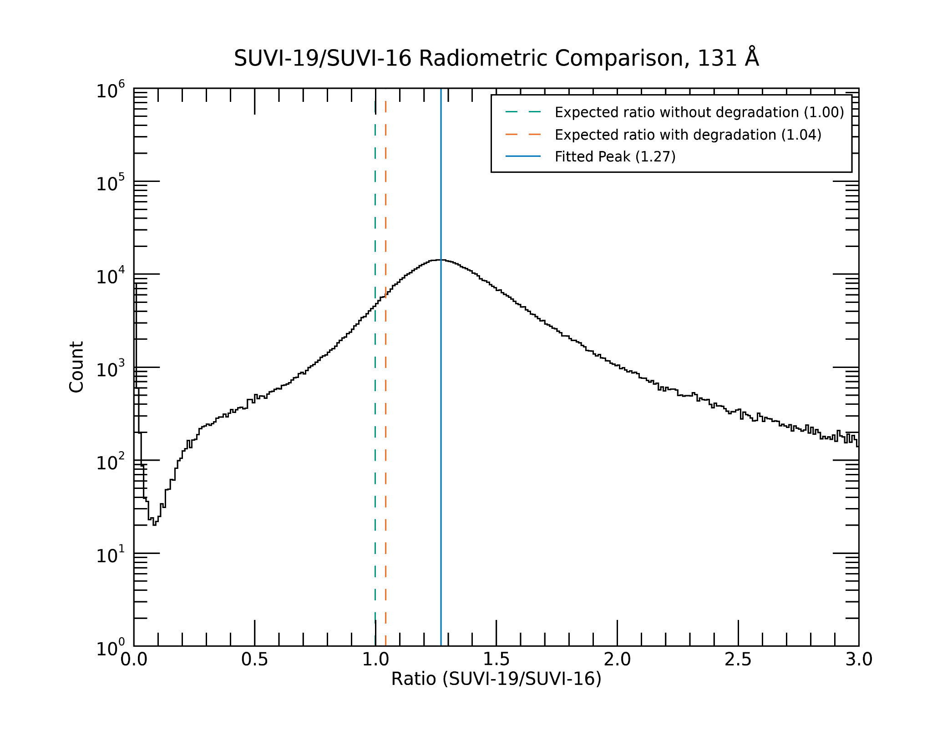
PLPT-SUVI-007: SUVI-SUVI Intercalibration
GOES-19 vs GOES-16
Quick explanation for the plots:
- orange dotted line: - green dotted line: - blue line:
expected with degradation expected w/o degradation reality
94 Å
131 Å

Slide 49
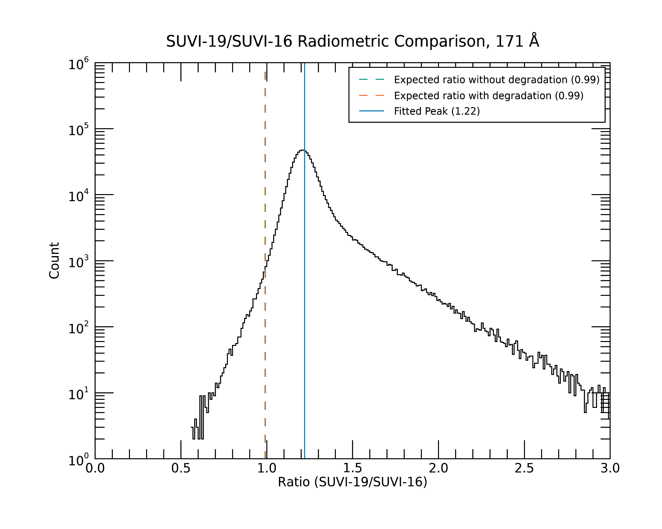
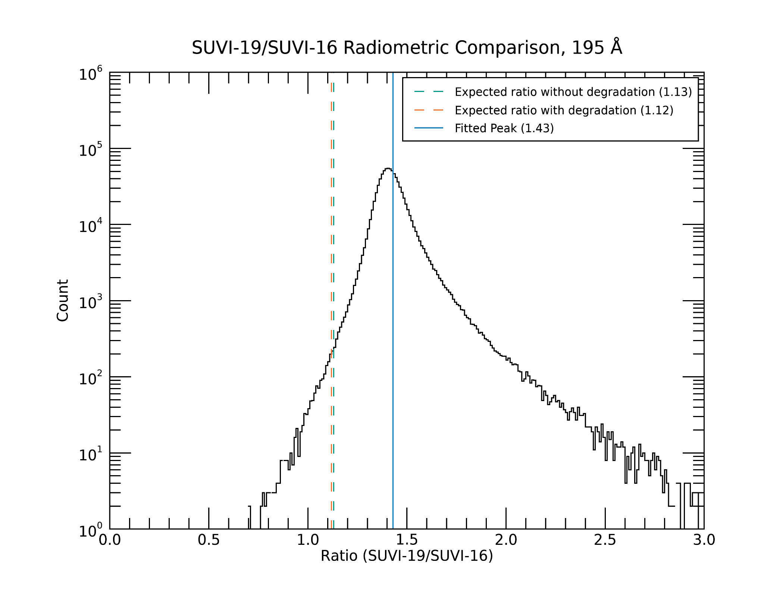
PLPT-SUVI-007: SUVI-SUVI Intercalibration
GOES-19 vs GOES-16
Quick explanation for the plots:
- orange dotted line: - green dotted line: - blue line:
expected with degradation expected w/o degradation reality
171 Å
195 Å

Slide 50
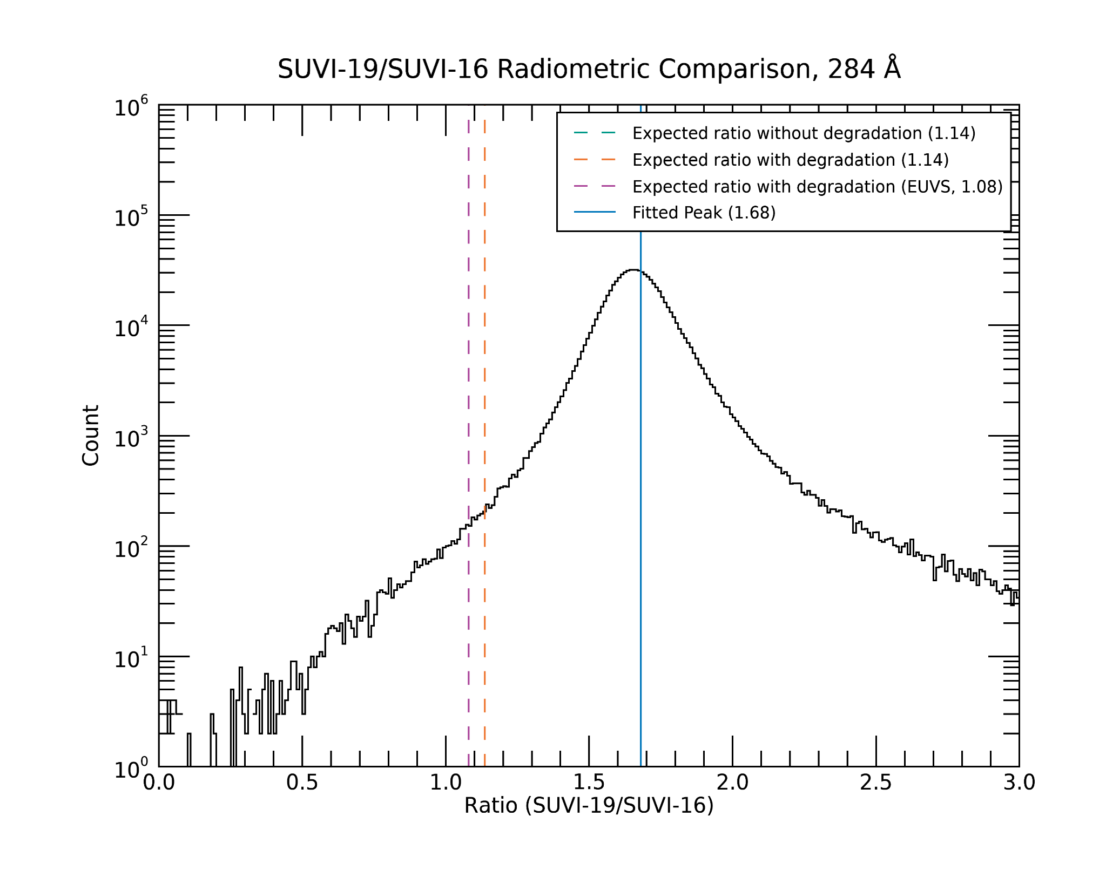
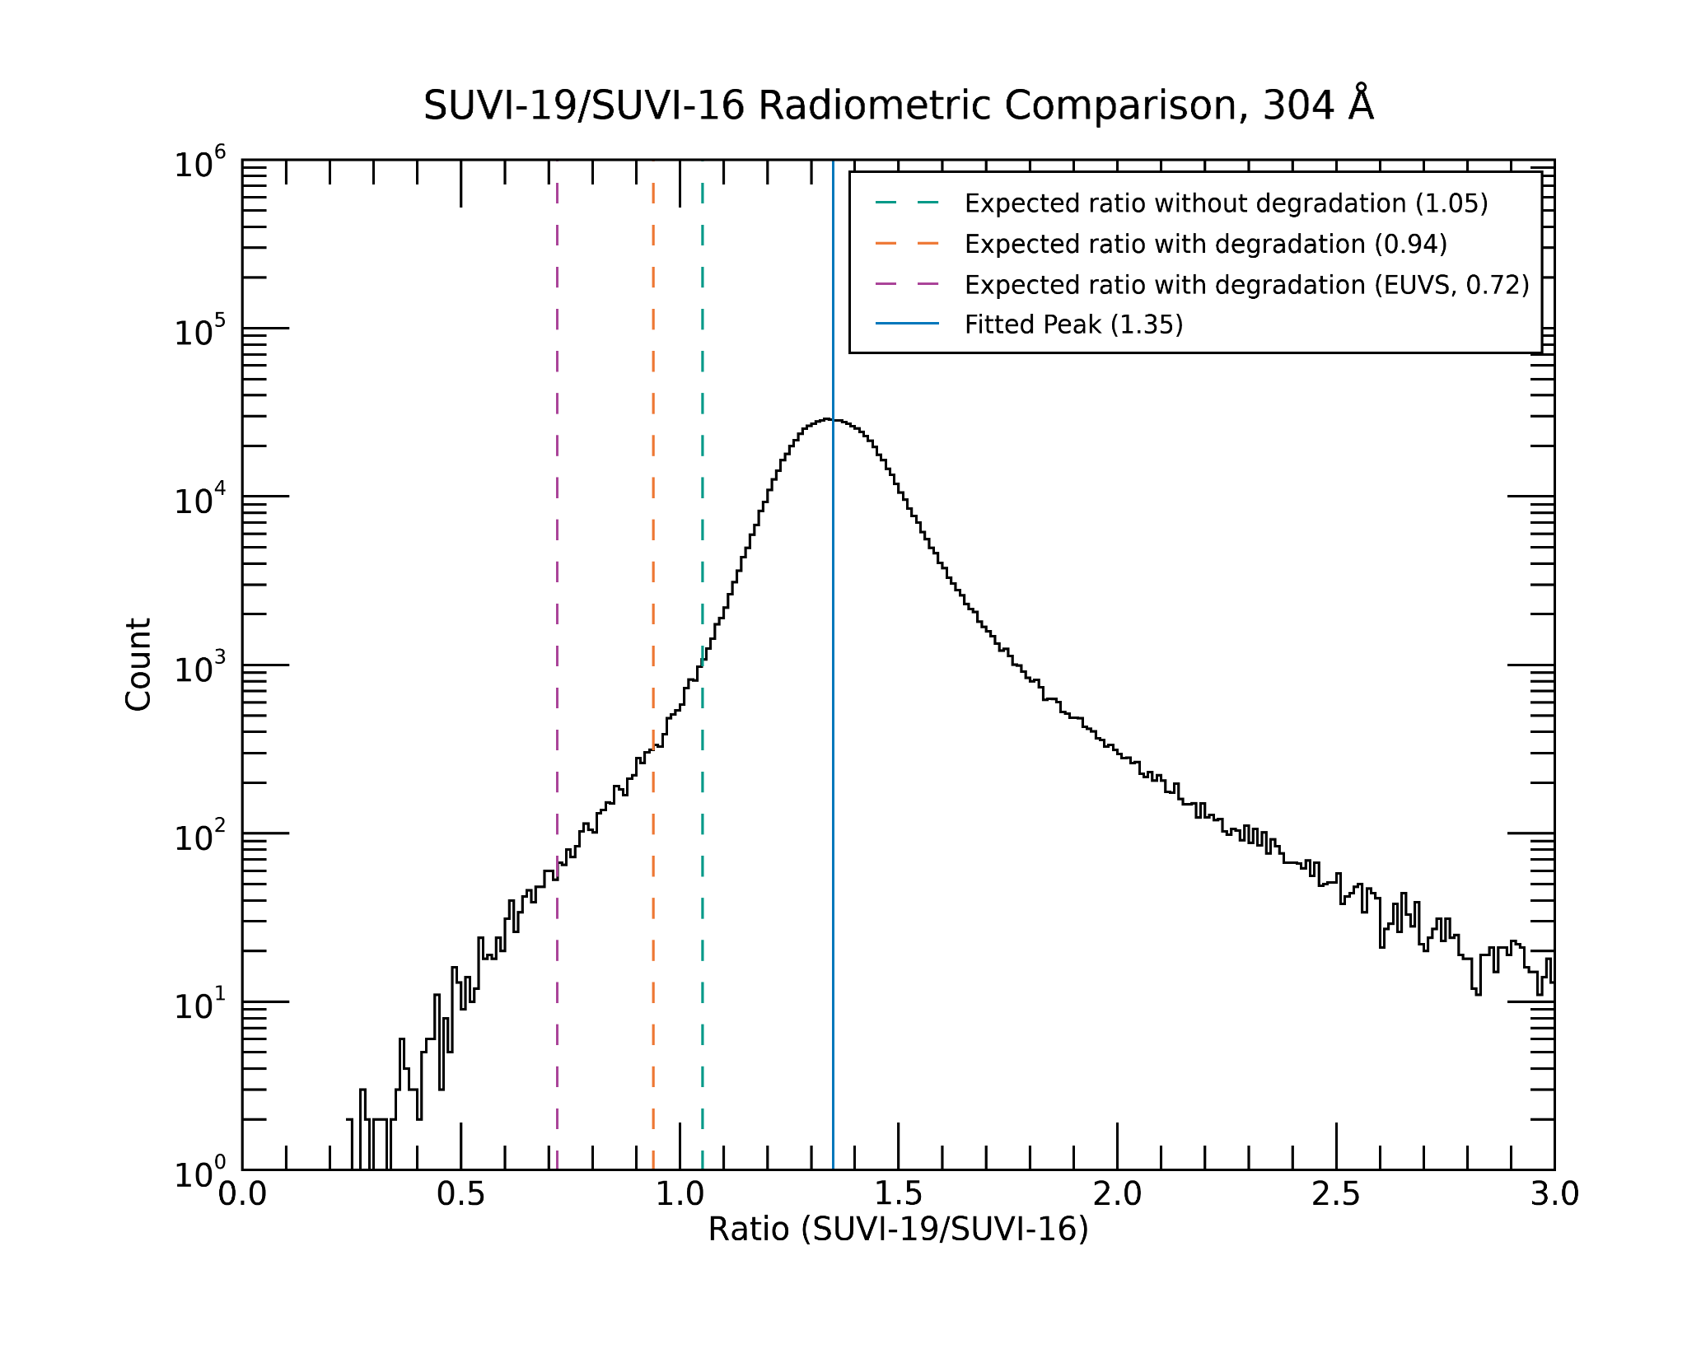
PLPT-SUVI-007: SUVI-SUVI Intercalibration
GOES-19 vs GOES-16
Quick explanation for the plots:
- orange dotted line: - green dotted line: - blue line:
expected with degradation expected w/o degradation reality
284 Å
304 Å

Slide 51
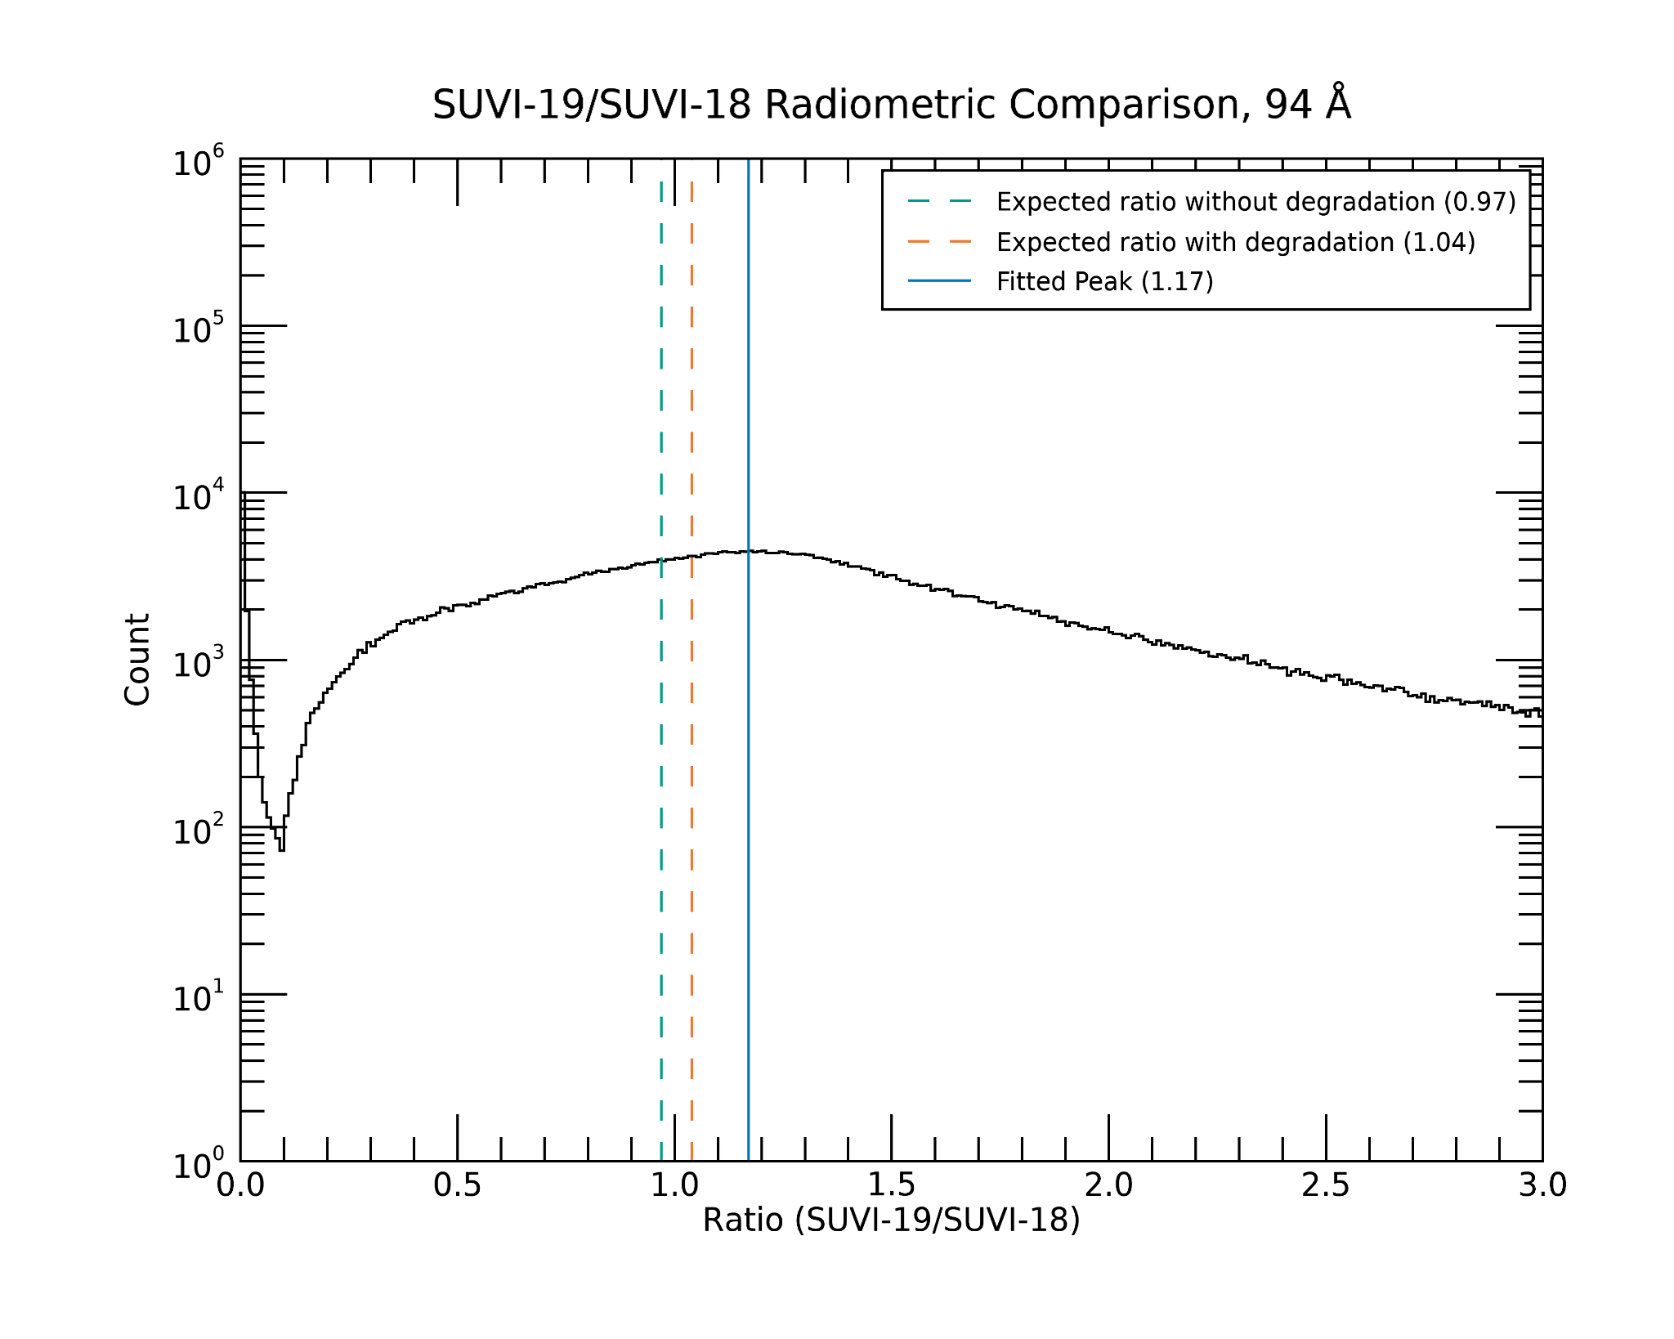
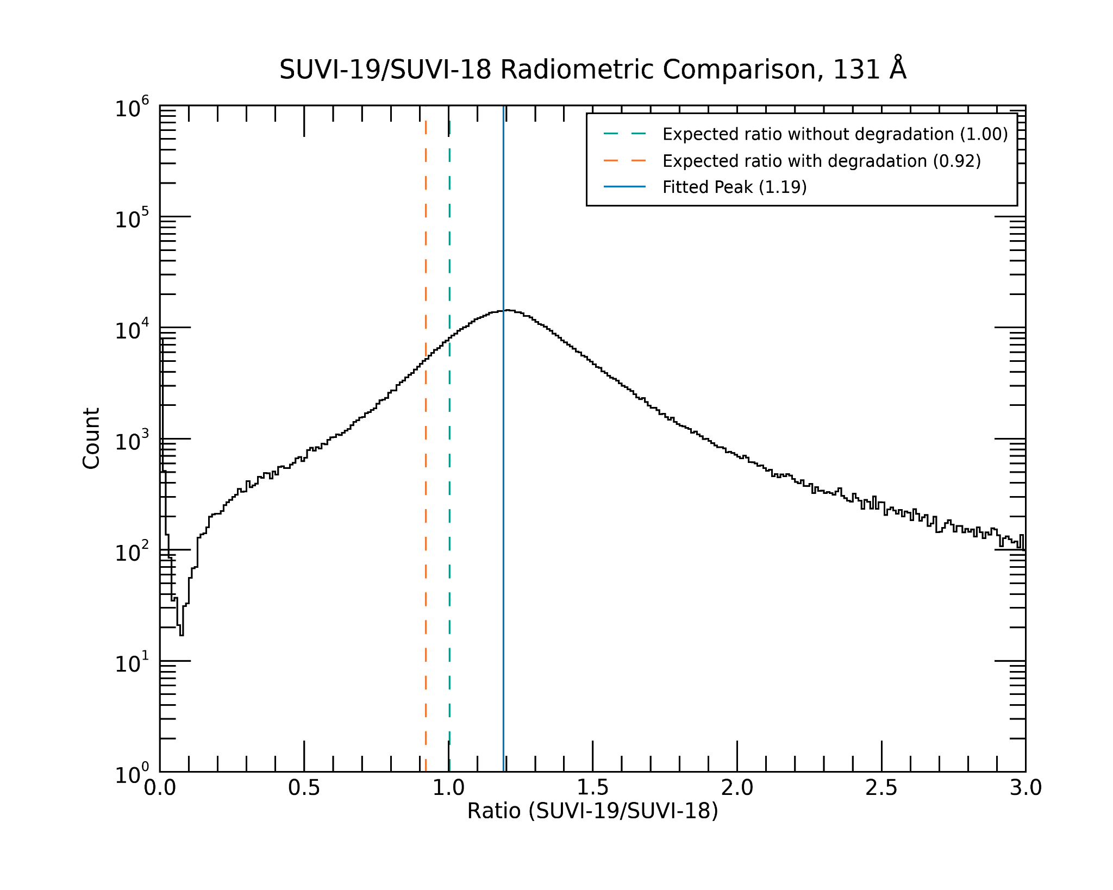
PLPT-SUVI-007: SUVI-SUVI Intercalibration
GOES-19 vs GOES-18
Quick explanation for the plots:
- orange dotted line: - green dotted line: - blue line:
expected with degradation expected w/o degradation reality
94 Å
131 Å

Slide 52
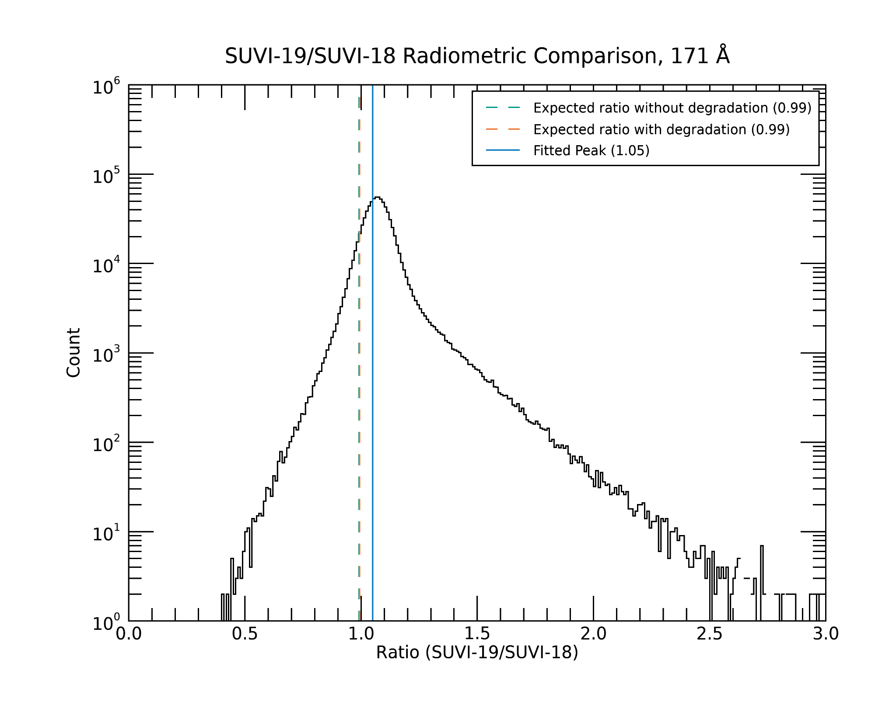
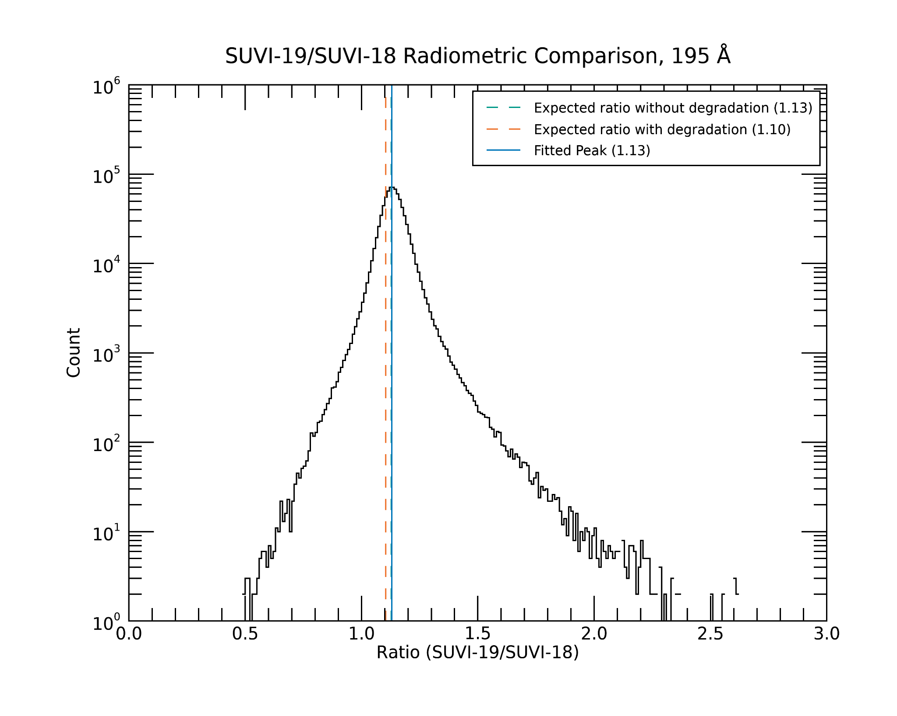
PLPT-SUVI-007: SUVI-SUVI Intercalibration
GOES-19 vs GOES-18
Quick explanation for the plots:
- orange dotted line: - green dotted line: - blue line:
expected with degradation expected w/o degradation reality
171 Å
195 Å

Slide 53
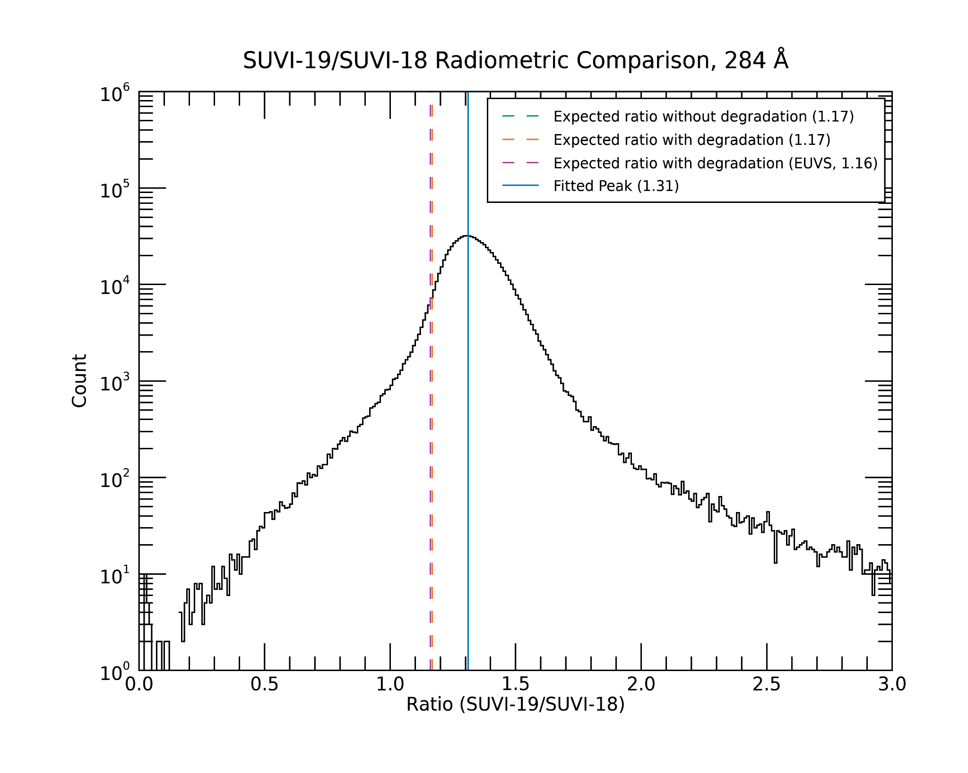
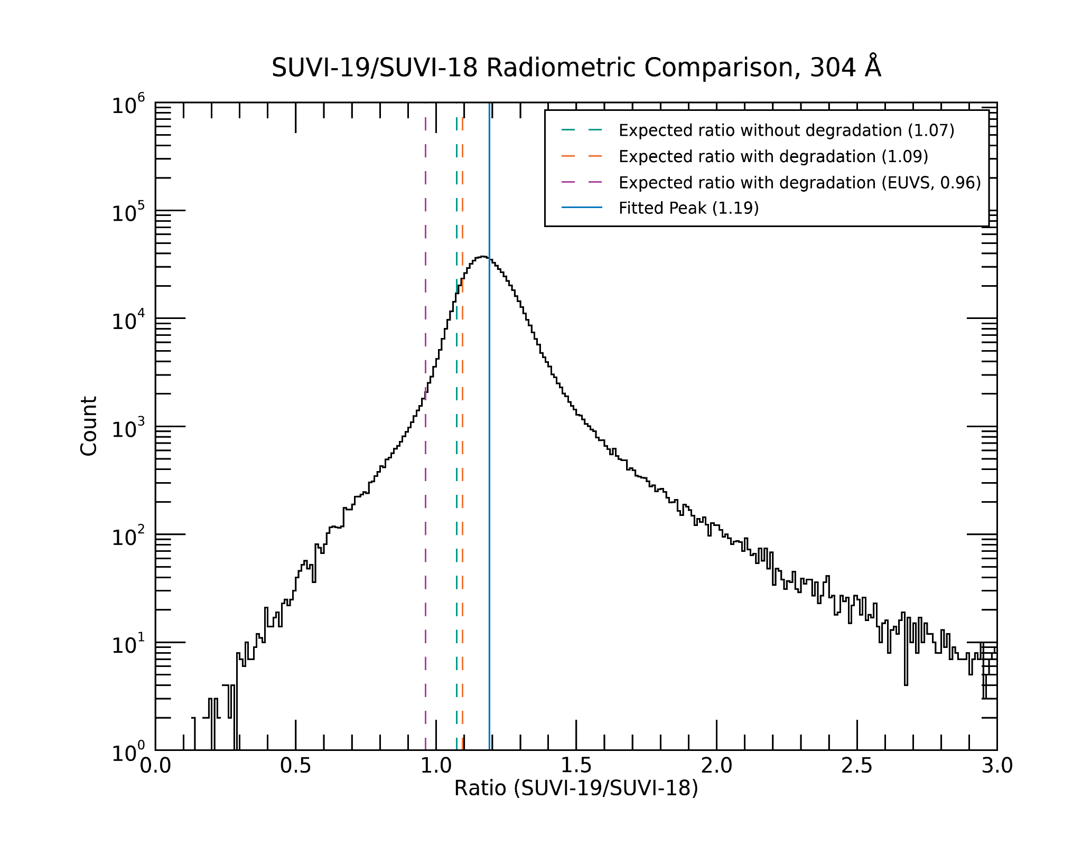
PLPT-SUVI-007: SUVI-SUVI Intercalibration
GOES-19 vs GOES-18
Quick explanation for the plots:
- orange dotted line: - green dotted line: - blue line:
expected with degradation expected w/o degradation reality
284 Å
304 Å

Slide 54
PLPT SUVI-007: SUVI-SUVI Intercomparison
Summary:
For most wavelength channels, the values between GOES-19 and GOES-18 are much closer than the ones between GOES-19 and GOES-16 estimates for the GOES-16 degradation are probably inaccurate.
Fundamental issue of this radiometric analysis: both the passband differences and the degradation influence the histograms. If we knew one of the two precisely, we could use this analysis to determine the other. Unfortunately, they cannot be disentangled.

Slide 55
PLPT-SUVI-006: SUVI-EXIS Intercalibration
Straight ratio comparison of EXIS-EUVSA 284 and 304Å spectral irradiance measurements to SUVI 284 and 304Å channels.
GOES-16 EXIS science products are used.
GOES-17 and -18 EUVS Level-2 products are not ready.
Value for the GOES-16 EXIS-EUVSA come from the NCEI scientific data.
SUVI and EXIS are very different instruments, and work is needed to achieve an apples-to-apples comparison.
The ratios between SUVI and EXIS measurements are an option in calculating the SUVI contamination correction.

Slide 56
Typical Solar Spectrum
He II (Si XI)
Fe IX
Fe X
Fe XII
(Fe XXIV)
Fe XV
Fe X
(Fe XVIII)
Fe VIII
(Fe XXI)

Slide 57
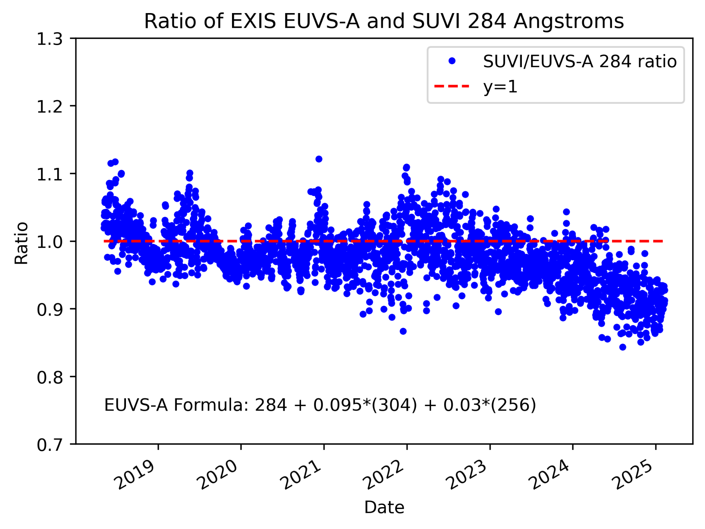
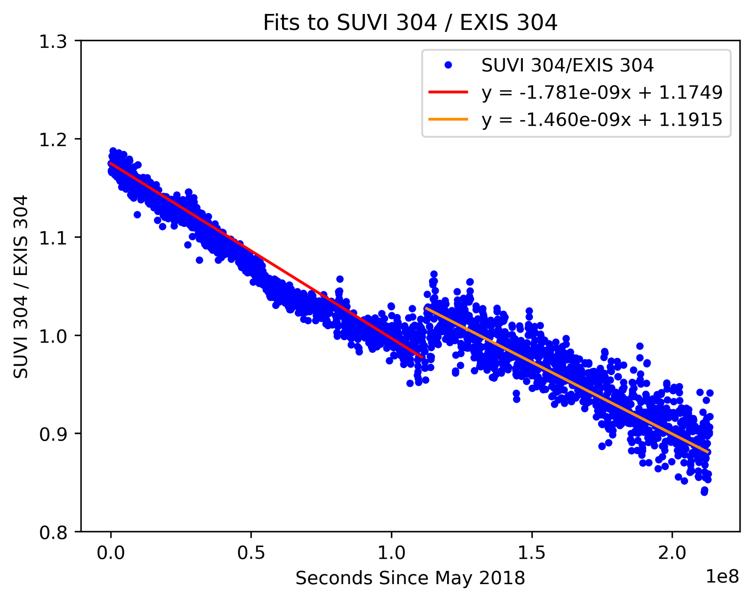
PLPT-SUVI-006: SUVI-EXIS Intercalibration
GOES-16 SUVI Retrospective
Bakeout

Slide 58
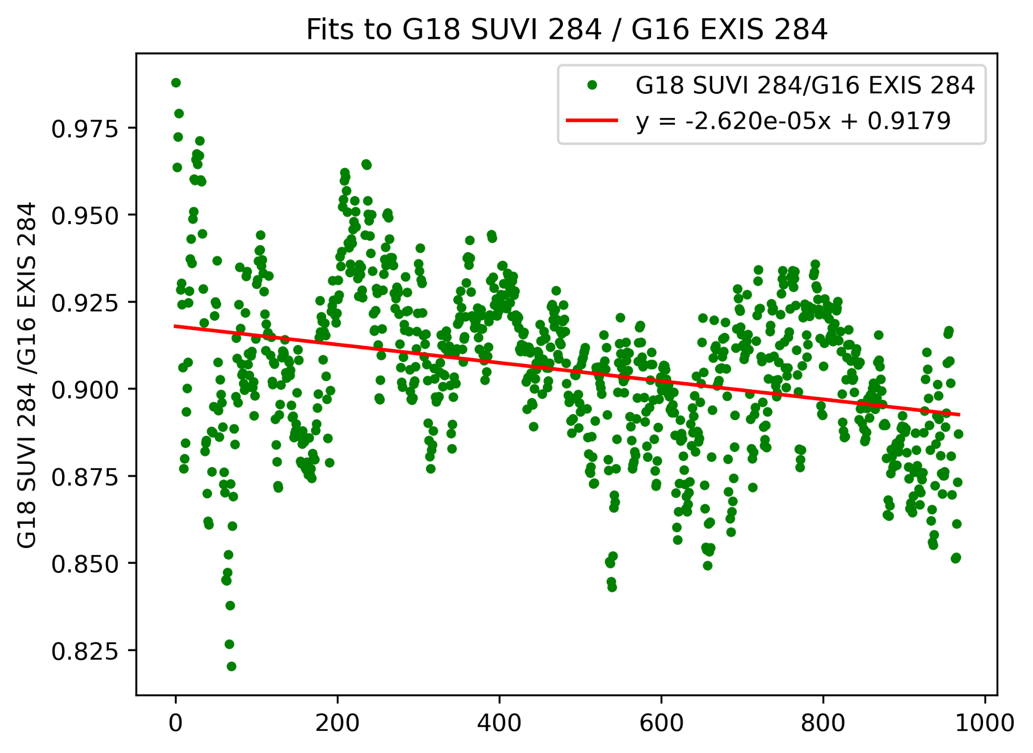
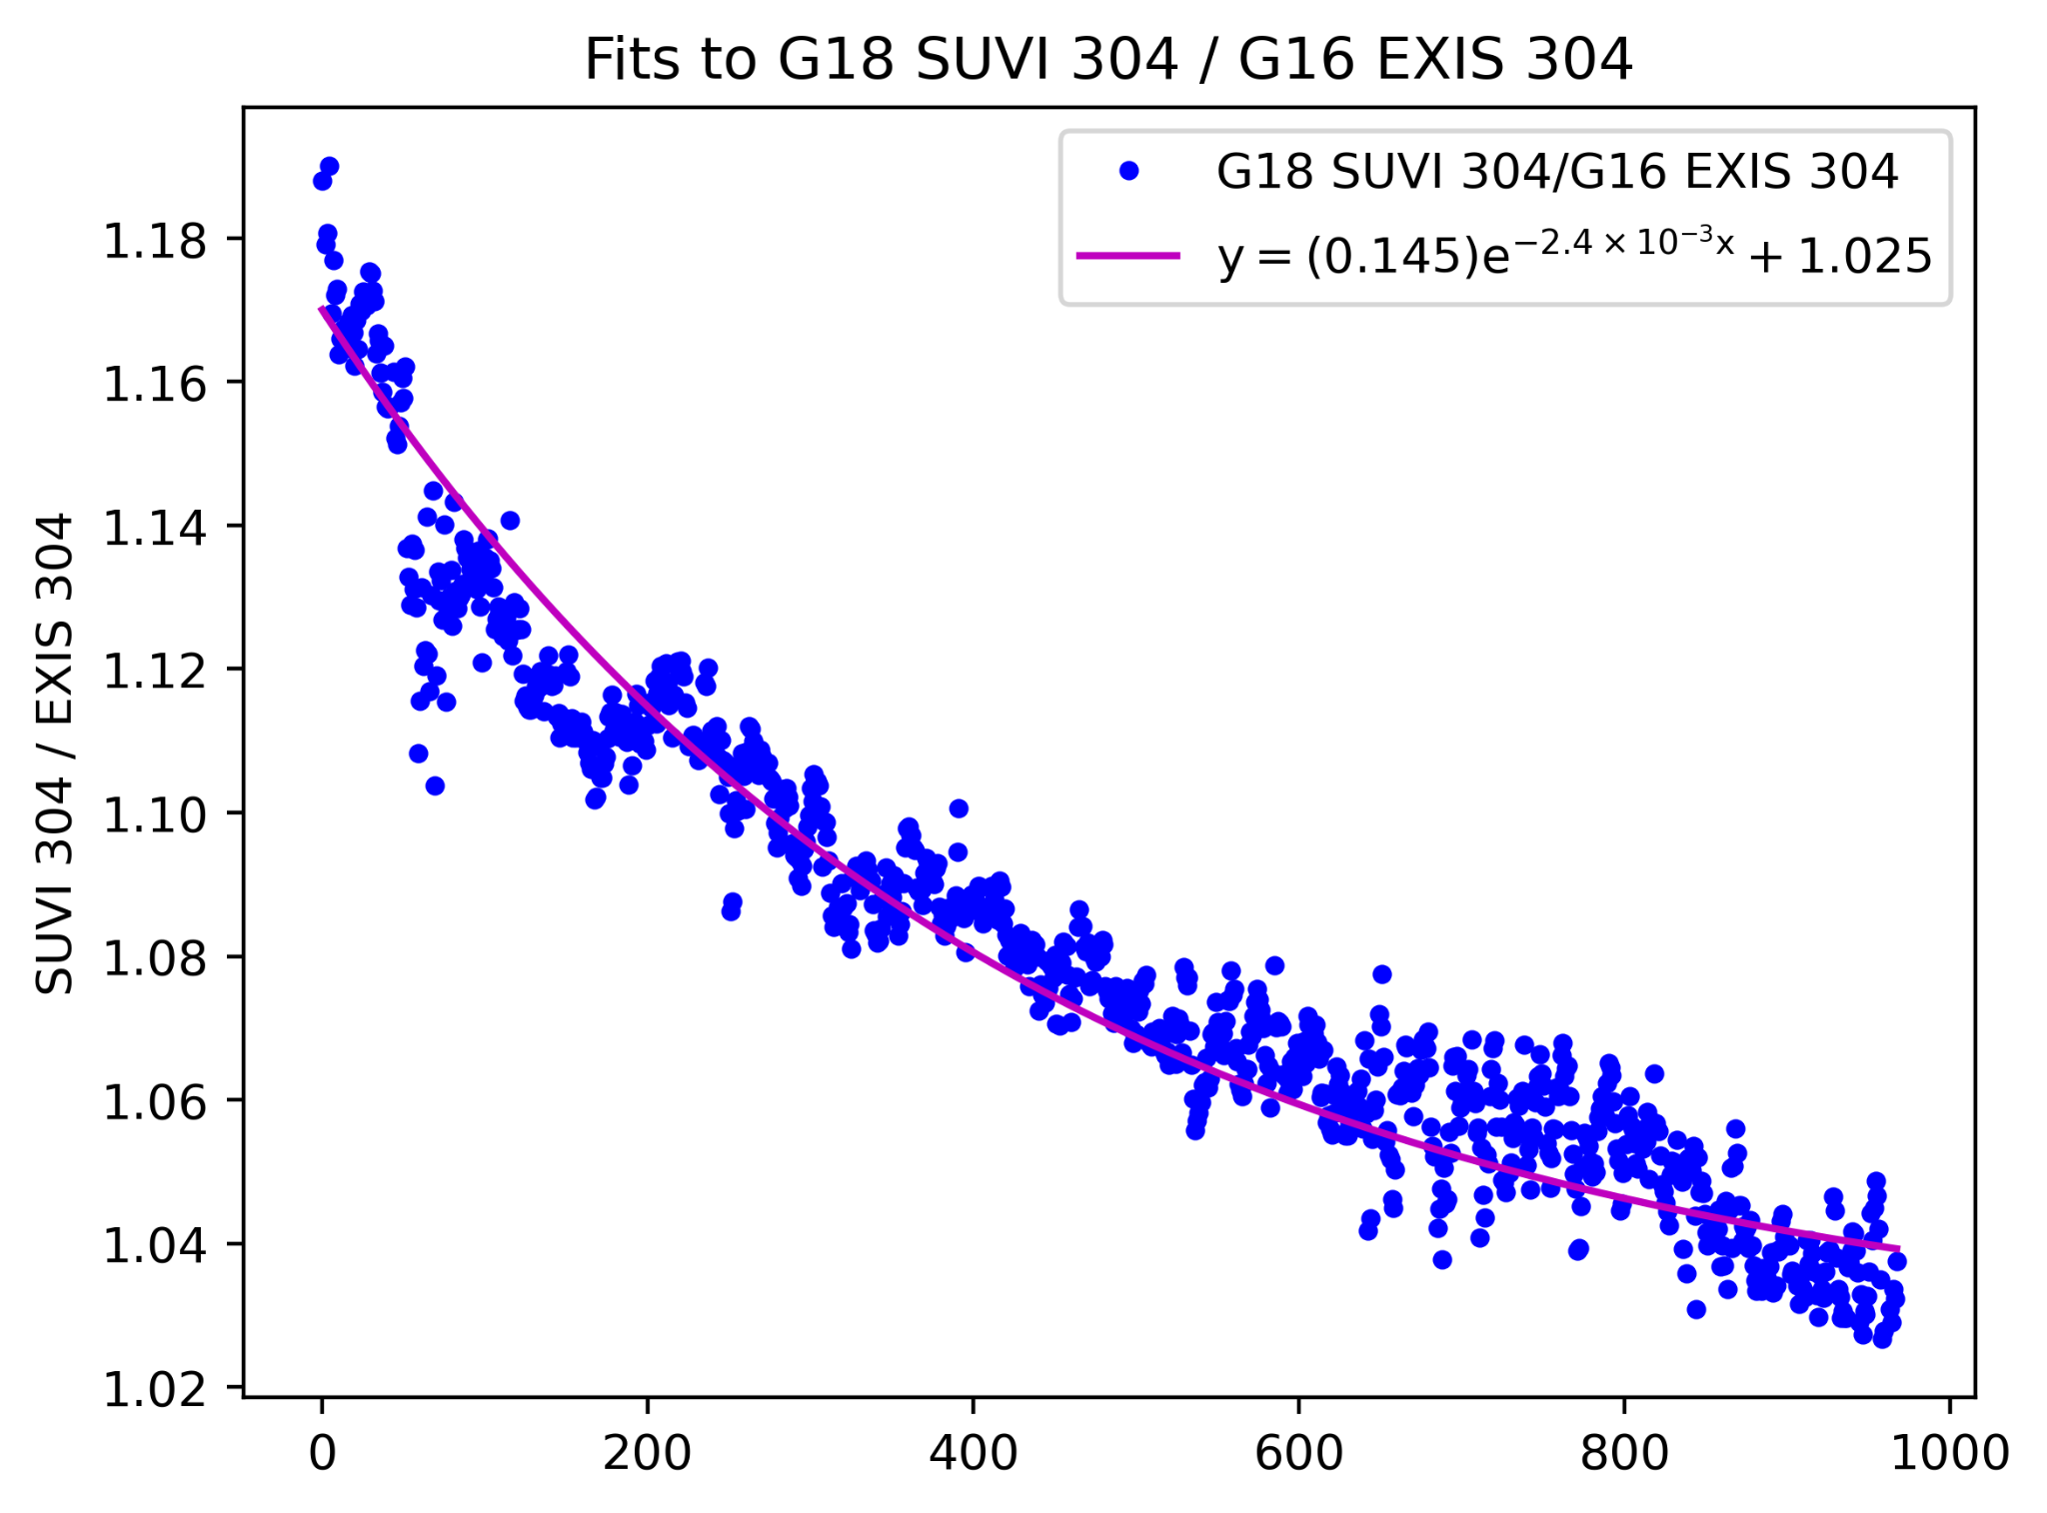
PLPT-SUVI-006: SUVI-EXIS Intercalibration
GOES-18 SUVI Retrospective

Slide 59
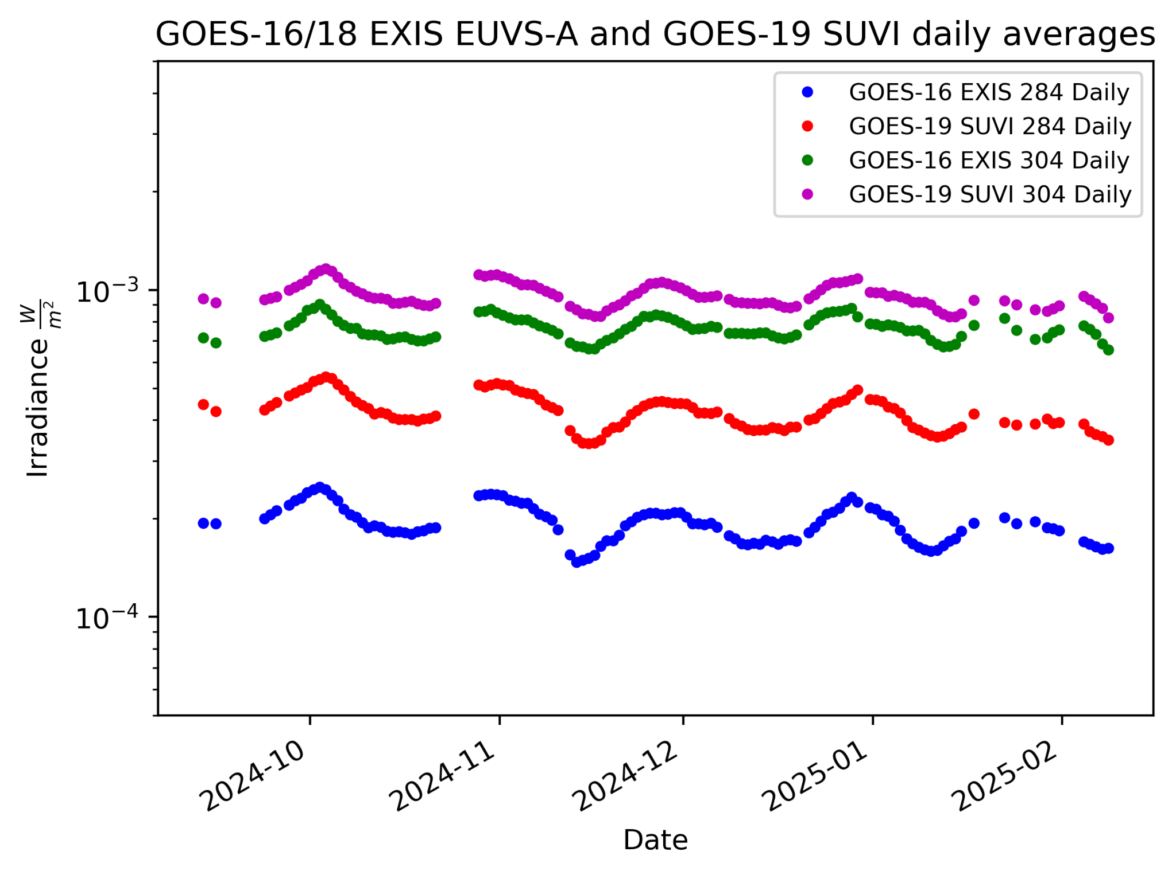
PLPT-SUVI-006: SUVI-EXIS Intercalibration
SUVI and EUVS measurements show similar trends.
Due to the broadband nature of the SUVI 284 and 304 channels, SUVI is observing more spectral lines than the discrete 284/304 lines measured by EXIS/EUVS-A.

Slide 60
PLPT-SUVI-006: SUVI-EXIS Intercalibration

Slide 61
PLPT-SUVI-006: SUVI-EXIS Intercalibration

Slide 62
SUVI Degradation Summary
Flight Model | 94 Å (AIA) | 131 Å (AIA) | 171 Å (AIA) | 195 Å (AIA) | 284 Å (EXIS) | 304 Å (AIA/EXIS)
FM1 | BSV | 5 | BSV | BSV | 18 | 15 / 32
FM3 | 24 | 16 | 5 | BSV | 10 | 3 / 15
FM4 | 30 | 9 | 5 | 4 | 3 | 5 / 2
FM1: 22 May 2018 to present
FM2: 22 May 2018 to Feb 2023
FM3: 18 June 2022 to present
FM4: 3 September 2024 to present
BSV : Below Solar Variability

Slide 63
SUVI Performance Baseline Status
Assessment at GOES-19 SUVI Provisional
MRD ID | Description | Related PLPTs | Status
2045 | Pointing Accuracy | PLPT-SUV-003 | Validated
2046 | Product Pointing Knowledge/Mapping Uncertainty | PLPT-SUV-003 | Ongoing Investigations
2052 | Long-term Stability (Product Measurement Precision in Radiance) | PLPT-SUV-003, PLPT-SUV-006 | Preliminary results. Ongoing investigation
MRD2045: Pointing Accuracy
Requirements: ±3.0 arcmin (3 sigma) (N-S,E-W) of Sun Center; Stability during 60 seconds: ±2.0 arcsec (1 sigma), ±6.0 arcsec (3 sigma) (N-S, E-W)
MRD2046: Product Pointing Knowledge/Mapping Uncertainty
Requirements: ±2.5 arcsec
MRD2052: Long-term Stability (Product Measurement Precision in Radiance)
Requirements: ±30%
Absolute accuracy cannot be verified on-orbit

Slide 64
SUVI Performance Baseline Status
Assessment at GOES-19 SUVI Provisional
MRD2045: Pointing Accuracy
Requirements: ±3.0 arcmin (3 sigma) (N-S,E-W) of Sun Center; Stability during 60 seconds: ±2.0 arcsec (1 sigma), ±6.0 arcsec (3 sigma) (N-S, E-W)
Pointing Error:
From limb fitting data in all channels: p_{err} = 0.758 arcmin << 3 arcmin

Slide 65
SUVI Performance Baseline Status
Assessment at GOES-19 SUVI Provisional
MRD2045: Pointing Accuracy
Requirements: ±3.0 arcmin (3 sigma) (N-S,E-W) of Sun Center; Stability during 60 seconds: ±2.0 arcsec (1 sigma), ±6.0 arcsec (3 sigma) (N-S, E-W)
Full resolution guide telescope data
30 seconds
Randomly chosen day (11 Jan 2025): requirement is met for most of the day, but not any 60 second window.

Slide 66
SUVI Performance Baseline Status
Assessment at GOES-19 SUVI Provisional
MRD ID | Description | Requirement | NCEI Analysis | Status
2045 | Pointing Accuracy | 3.0 Arcminutes | 0.758 arcmin 1.21 arcsec (3 sigma) | PASS
2046 | Product Pointing Knowledge/ Mapping Uncertainty | 2.5 Arcseconds | x_{diff} : 0.038 ± 2.179 arcsec y_{diff} : 0.265 ± 0.777 arcsec | PASS
2052 | Long-term Stability | 30% | 3.6% | PASS
Pointing requirements are Met.
Long-term Stability was calculated using the standard error to the fitted trend for GOES-19 SUVI/AIA 94Å degradation.

Slide 67
SUVI Product Maturity Assessment
Entry Point: GOES-19 SUVI Beta
Preparation Activities | Assessment
Validation activities are ongoing and the general research community is now encouraged to participate. | Validation activities are ongoing. Regular communication is held with SWPC about any and all SUVI issues. NCEI engages with the scientific community to enable and encourage the use of SUVI datasets.
Severe algorithm anomalies and deficiencies are identified and under analysis. Solutions to anomalies are in development and testing. | NCEI is pursuing efforts to reprocess SUVI datasets to correct SUVI INR and calibration offset issues.
Incremental product improvements may still be occurring. | Incremental product improvements in the form of LUT updates are ongoing.

Slide 68
SUVI Product Maturity Assessment
Assessment Point: GOES-19 SUVI Provisional
End State | Assessment
Product performance has been demonstrated through analysis of a small number of independent measurements obtained from select locations, periods, and associated ground truth or field campaign efforts. | PLPTs discussed here demonstrate the product performance of the GOES-19 SUVI
Product analysis is sufficient to communicate product performance to users relative to expectations (Performance Baseline). | Yes.
Documentation of product performance exists that includes recommended remediation strategies for all anomalies and weaknesses. Any algorithm changes associated with severe anomalies have been documented, implemented, tested, and shared with the user community. | Preliminary assessments show the instrument and product are in good shape. All anomalies and other concerns will be discussed within product documentation.
Testing has been fully documented. | This presentation, additional documentation to follow, and presentations to SWPC and the scientific community.
Product is ready for operational use and for use in comprehensive cal/val activities and product optimization. | NCEI: yes.

Slide 69
Path to Full Maturity: GOES-19 SUVI
All ADRs, WRs, and risks critical to the quality of the GOES-19 SUVI Level-1b product need to be resolved prior to Full Maturity.
Analysis of all GOES-19 SUVI PLPTs needed for Full Maturity completed
Assessment of GOES-19 SUVI against Performance Baseline Metrics.

Slide 70
NWS-SWPC Disposition
Comments from Dr. Steven Hill of SWPC, speaking on behalf of the user community on the maturity and readiness of the GOES-19 SUVI Level-1b product.

Slide 71
Summary and Conclusion
GOES-19 SUVI Provisional Maturity
All ADRs/WRs critical to Provisional Maturity have been resolved, validated, or had a path of resolution defined.
We would like to thank the instrument vendor, ground system vendor, OSPO, and the GOES-R Program team for all the help to reach this milestone.
NCEI-CO and SWPC recommend the GOES-19 SUVI L1b product for Provisional Maturity

Slide 72
Back-Up Slides

Slide 73
Long-Term SUVI-AIA Intercalibration (94 Å)

Slide 74
Long-Term SUVI-AIA Intercalibration (131 Å)

Slide 75
Long-Term SUVI-AIA Intercalibration (171 Å)

Slide 76
Long-Term SUVI-AIA Intercalibration (195 Å)

Slide 77
Long-Term SUVI-AIA Intercalibration (304 Å)

Slide 78
SUVP-PLPT-007: SUVI-SUVI 94Å Daily Average Ratio

Slide 79
SUVP-PLPT-007: SUVI-SUVI 131Å Daily Average Ratio

Slide 80
SUVP-PLPT-007: SUVI-SUVI 171Å Daily Average Ratio

Slide 81
SUVP-PLPT-007: SUVI-SUVI 195Å Daily Average Ratio

Slide 82
SUVP-PLPT-007: SUVI-SUVI 284Å Daily Average Ratio

Slide 83
SUVP-PLPT-007: SUVI-SUVI 304Å Daily Average Ratio

