Slide 1
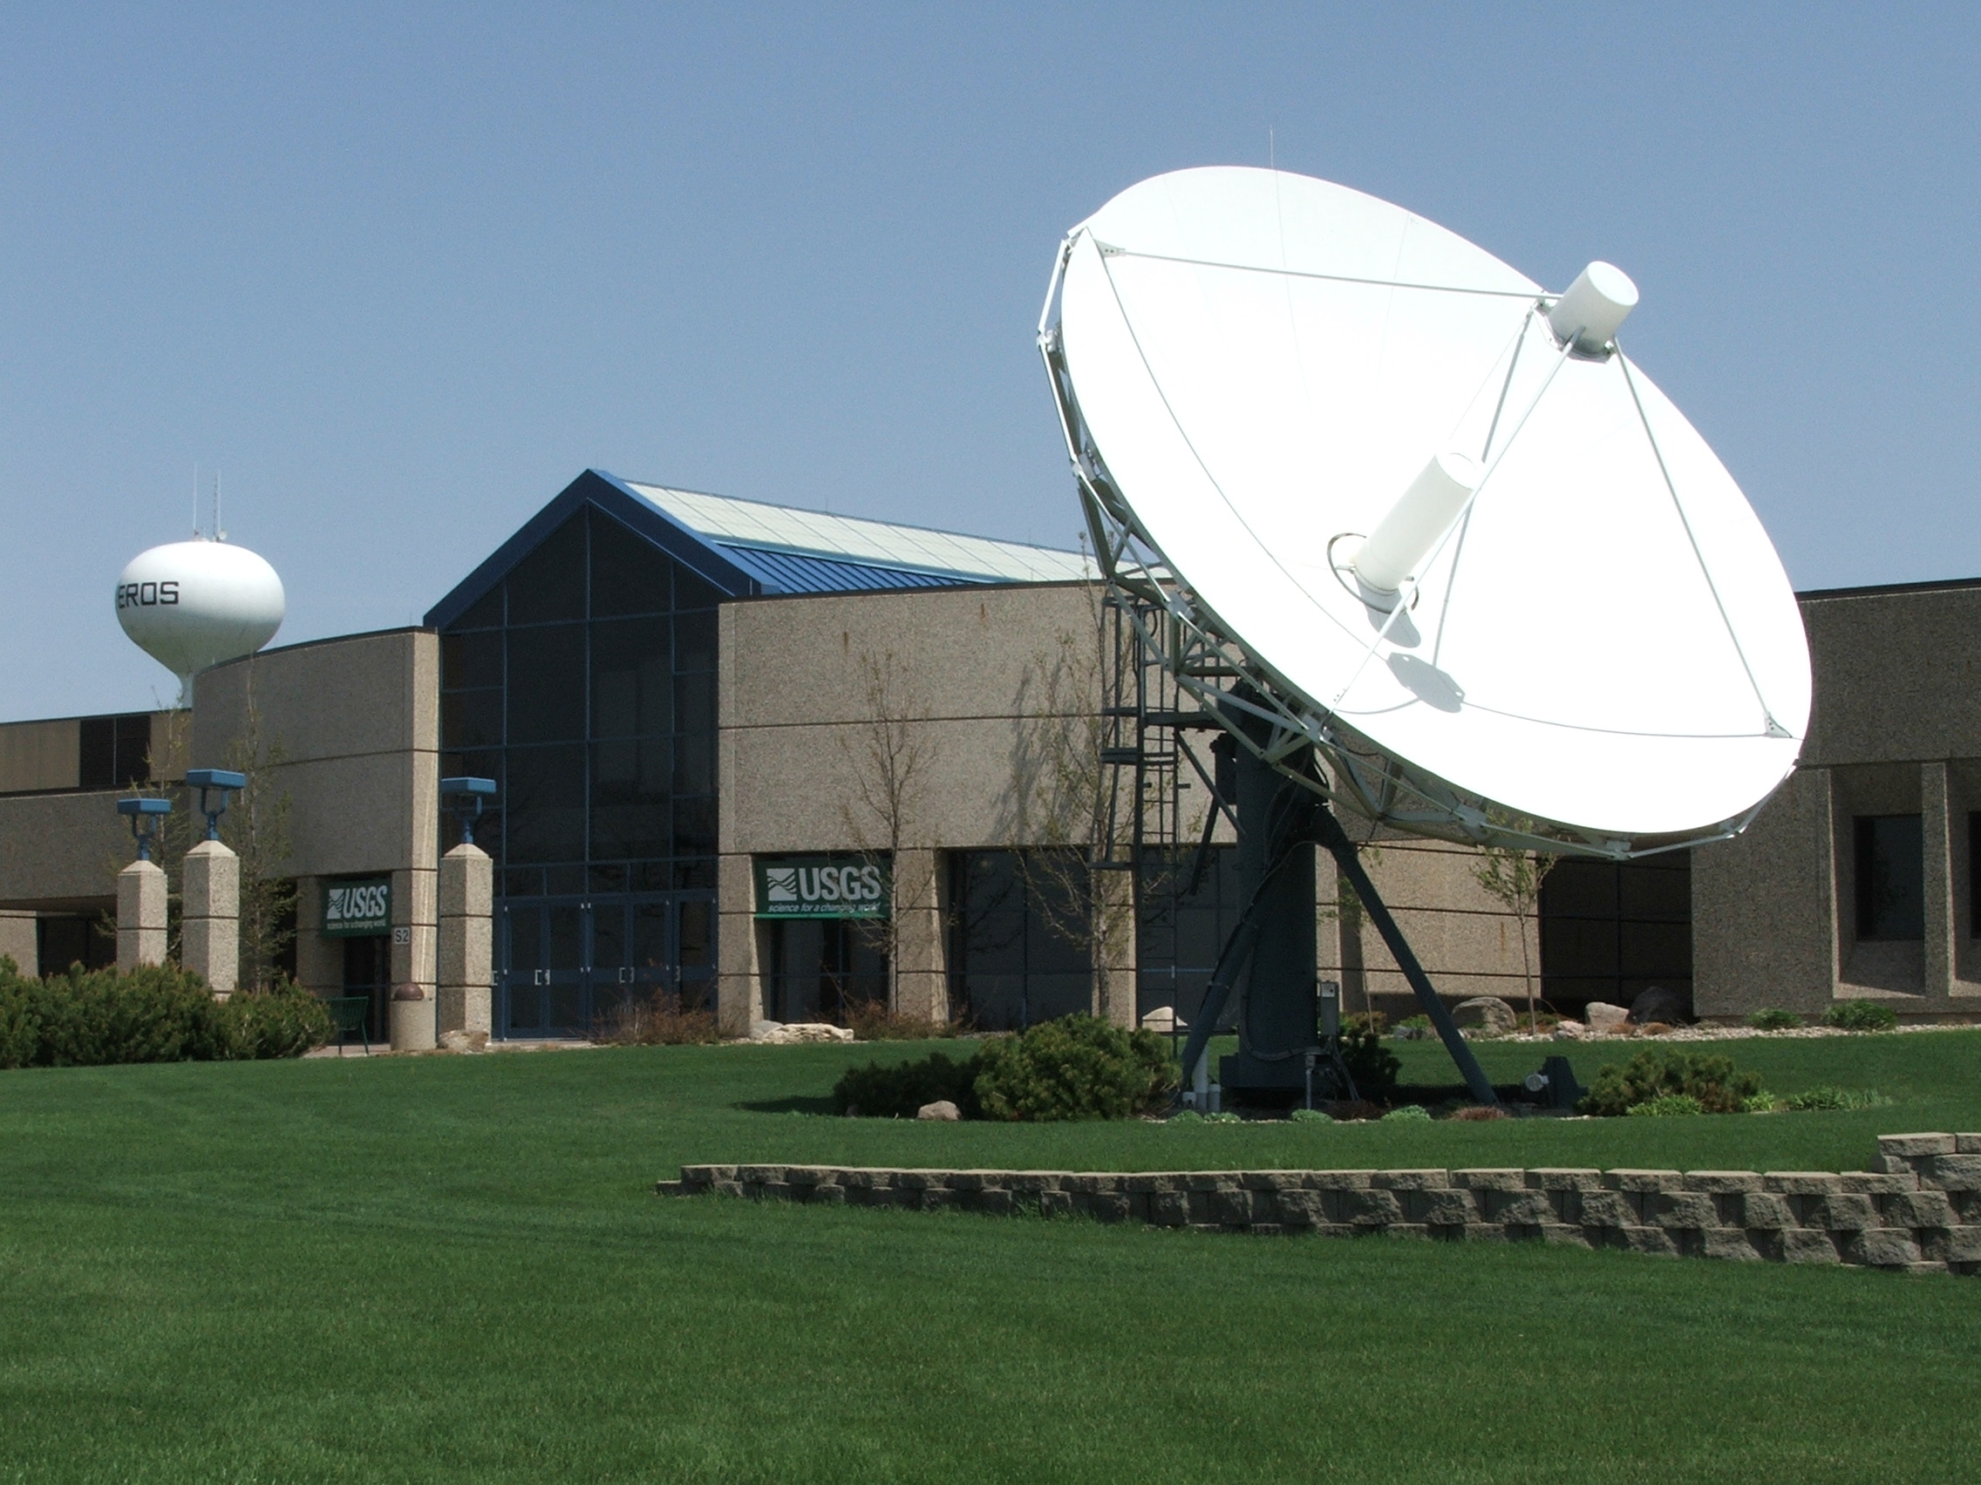
Status of GOES
Emergency Data
Distribution
Network(EDDN)
at EROS
Dan Schwitalla – USGS
28 October 2009 – TWG Meeting
Chincoteague Island, VA

Slide 2
Basic EDDN System
Satellite downlink system with 2 antennas for GOES East and West ( at least 7M )‏ and one backup antenna
DOMSAT receive system for data from Wallops Island
LRGS systems for acquiring and distributing data.
Web Server for reporting system status.

Slide 3
8.1M Antenna at EROS for GOES East

Slide 4
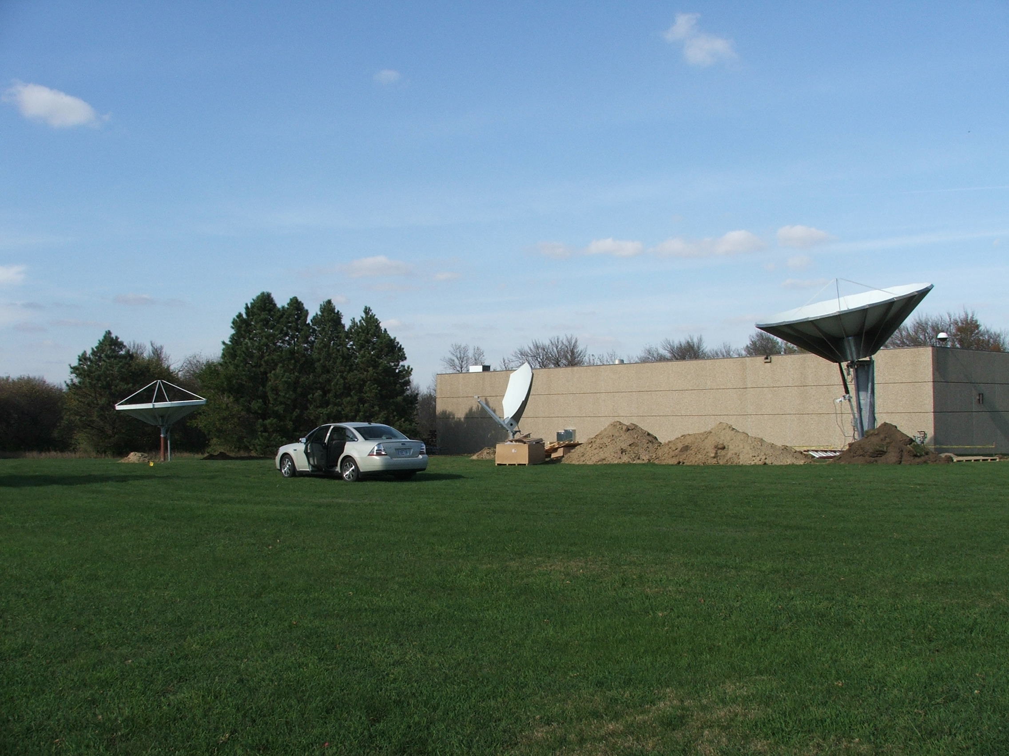
Three New Antennas (3.8M backup, 2.4M DOMSAT, 7.5M GOES West)

Slide 5
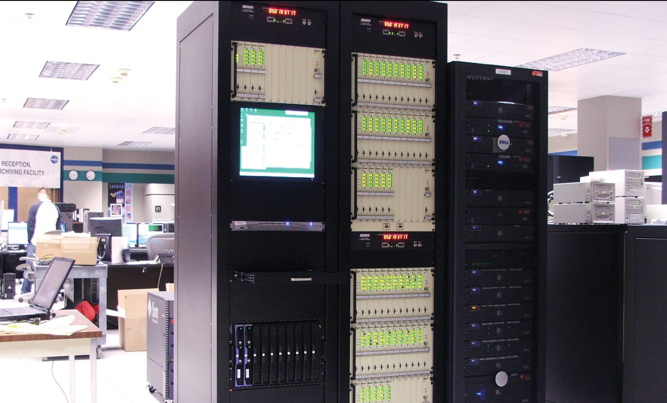
GOES Receive Equipment at EROS

Slide 6
Annual Maintenance of the EDDN
Maintenance was performed on 14-18 September 2009.
Antennas were exercised.
Levels checked
Dishes cleaned
Installed 8 new Quad DigiTrak Demodulator cards.
Updated DAMS-NT receive system
Updated Dual Pilot Control Modules (DPCM)

Slide 7
Future Enhancements to the EDDN
Procuring two data servers to add new capability to the EDDN.
New Public Server
Web site host
National configuration database
Health monitoring
New USGS Server
One year message storage
Message warehouse for the USGS

Slide 8
EDDN LRGS Addressing Changes
Currently:
eddn.usgs.gov equals lrgseddn1.cr.usgs.gov
Make sure your LRGS clients point to:
lrgseddn1.cr.usgs.gov

Slide 9
Contact Information
Dan Schwitalla
US Geological Survey
Maryland Water Science Center
Baltimore, MD
443-498-5605
ddschwit@usgs.gov

